Slide 1
Random-effect Models for Longitudinal Data
장문수
Notes:
r

Slide 2
0. Summary
What is the Longitudinal data
Compare Multivariate model and Two-stage random-effect model
Unified approach to fitting these models
Two examples

Slide 3
1.Introduction
Longitudinal data
2) two-stage model

Slide 4
1.Introduction
Longitudinal Data(종적 데이터)
- 실험 참가자를 시간을 들여 여러 번 반복하여 측정한 데이터
- 각 객체들이 서로 다른 시간에 측정되거나 연구가 진행됨에 따라 사라질 수도 있음
- longitudinal data는 일반적으로 unbalanced data인 경우가 많음
Ex) 환자들의 혈압, 콜레스테롤 수준, 폐활량, 혈청 포도당 등을 3개월 마다 측정한 데이터

Slide 5
1.Introduction
Longitudinal Data(종적 데이터)
-unbalanced data경우 multivariate model은 좋지 않다.
Multivariate model을 사용할 경우 추정해야 할 분산의 모수가 너무 급증하기 때문
-two-stage model을 사용하는 것이 더욱 효과적

Slide 6
1.Introduction
Two-stage model
- balanced data일 필요가 없다. 하지만 분산구조에 대한 가정이 필요
- stage 1 : within-person variation
- stage 2 : between-person variation

Slide 7
1.Introduction
Two-stage model
-two-stage model의 경우 각 객체들의 분포는 같은 분포지만,
분포의 모수들은 다름.
Ex) 어린이들의 폐활량은 키의 세제곱과 선형관계에 있을 것이다.
하지만 회귀식의 모수들은 어린이들마다 다를 것이다.

Slide 8
2.Model
Multivariate model
Two-stage random-effect model

Slide 9
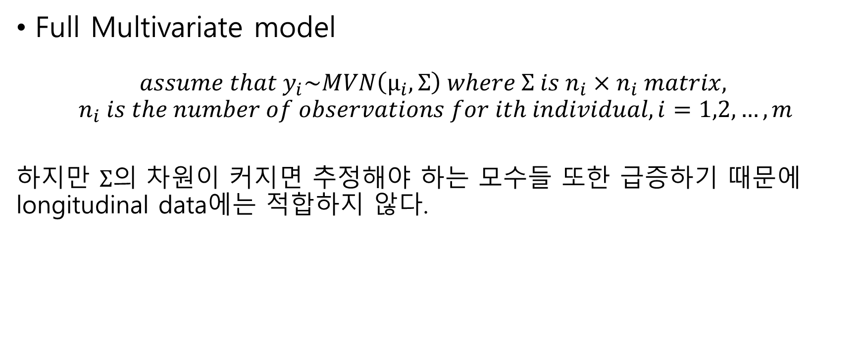
2.Models
Full Multivariate model
$$assume that y_{i}\sim MVN\left(μ_{i},Σ\right) where Σ is n_{i}×n_{i} matrix,$$
$$n_{i} is the number of observations for ith individual, i=1,2,…,m$$
하지만 $Σ$의 차원이 커지면 추정해야 하는 모수들 또한 급증하기 때문에 longitudinal data에는 적합하지 않다.

Slide 10
2.Models
Two-stage random-effect model
- 객체 내 변동과 객체 간 변동에 대한 분석을 따로 실시한다.
그렇기 때문에 객체들 마다 measurement의 수가 차이가 나는 unbalanced data에도 적용이 가능하다.
Two-stage random-effect model은 크게 growth-curve 와 repeated measures model로 구분된다.

Slide 11
2.Models
Two-stage random-effect model
-growth curve model
: 자연적인 성장이나 aging process에 의한 객체 내 변동에 초점을 둔 모델
-repeated measures model
:Individual effect는 시간에 영향을 받지 않는 고정효과로 간주하며,
Experimental condition은 의도되었든 그렇지 않든 within-person variation에 영향을 주며, 통제된 실험환경 하에서 연구를 진행함

Slide 12
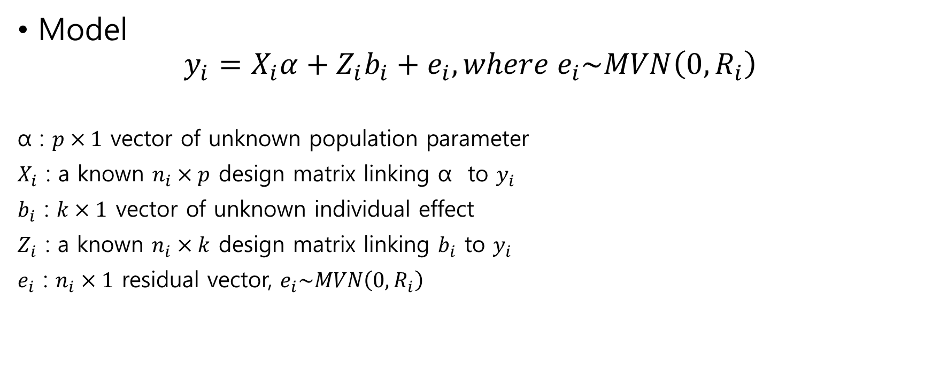
2.Models
Model
$$y_{i}=X_{i}α+Z_{i}b_{i}+e_{i}, where e_{i}\sim MVN\left(0,R_{i}\right)$$
α : $p×1$ vector of unknown population parameter
$X_{i}$ : a known $n_{i}×p$ design matrix linking α to $y_{i}$
$b_{i}$ : $k×1$ vector of unknown individual effect
$Z_{i}$ : a known $n_{i}×k$ design matrix linking $b_{i}$ to $y_{i}$
$e_{i}$ : $n_{i}×1$ residual vector, $e_{i}\sim MVN\left(0,R_{i}\right)$

Slide 13
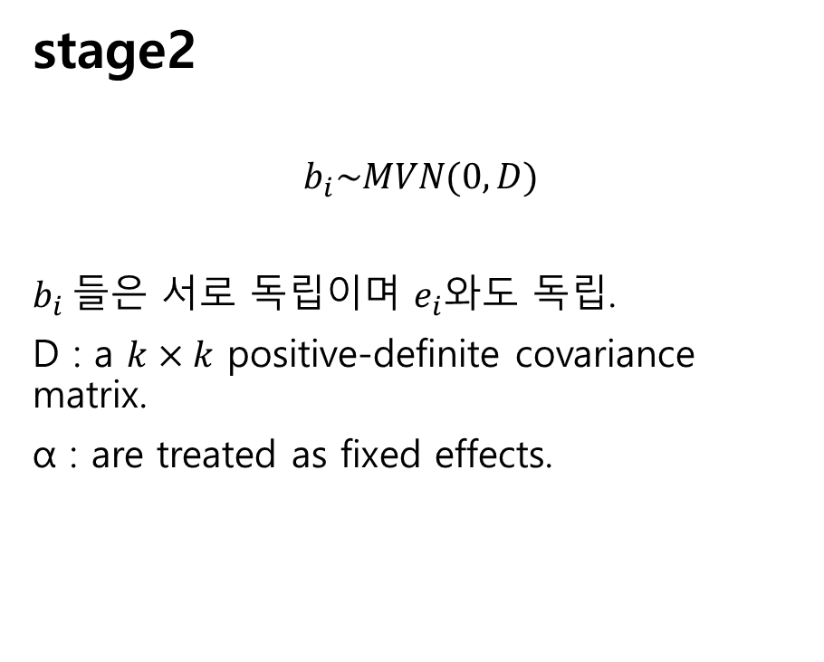
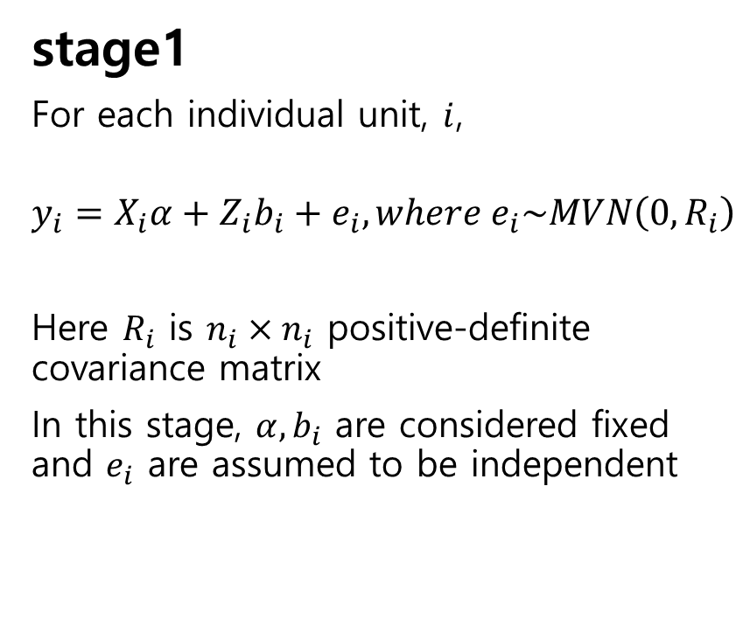
2.Models
stage1
For each individual unit, $i$,
$$y_{i}=X_{i}α+Z_{i}b_{i}+e_{i}, where e_{i}\sim MVN\left(0,R_{i}\right)$$
Here $R_{i}$ is $n_{i}×n_{i}$ positive-definite covariance matrix
In this stage, $α,b_{i}$ are considered fixed and $e_{i}$ are assumed to be independent
stage2
$$b_{i}\sim MVN(0,D)$$
$b_{i}$들은 서로 독립이며 $e_{i}$와도 독립.
D : a $k×k$ positive-definite covariance matrix.
α : are treated as fixed effects.

Slide 14
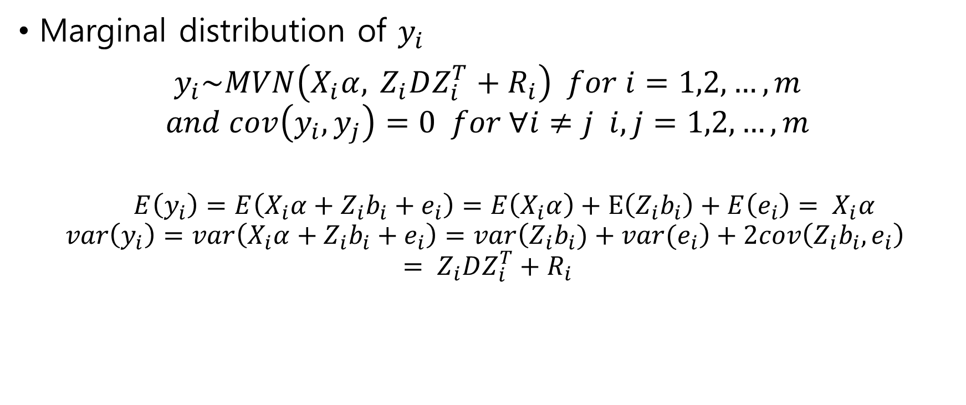
2.Models
Marginal distribution of $y_{i}$
$${ y}_{i}\sim MVN\left(X_{i}α, { Z}_{i}DZ_{i}^{T}+R_{i}\right) for i=1,2,…,m$$
$$and cov\left(y_{i},y_{j}\right)=0 for ∀i≠j i,j=1,2,…,m$$
$E\left(y_{i}\right)=E\left(X_{i}α+Z_{i}b_{i}+e_{i}\right)=E\left(X_{i}α\right)+E\left(Z_{i}b_{i}\right)+E\left(e_{i}\right)= X_{i}α$
$$var\left(y_{i}\right)=var\left(X_{i}α+Z_{i}b_{i}+e_{i}\right)=var\left(Z_{i}b_{i})+var(e_{i}\right)+2cov\left(Z_{i}b_{i},e_{i}\right)$$
$$= Z_{i}DZ_{i}^{T}+R_{i}$$

Slide 15
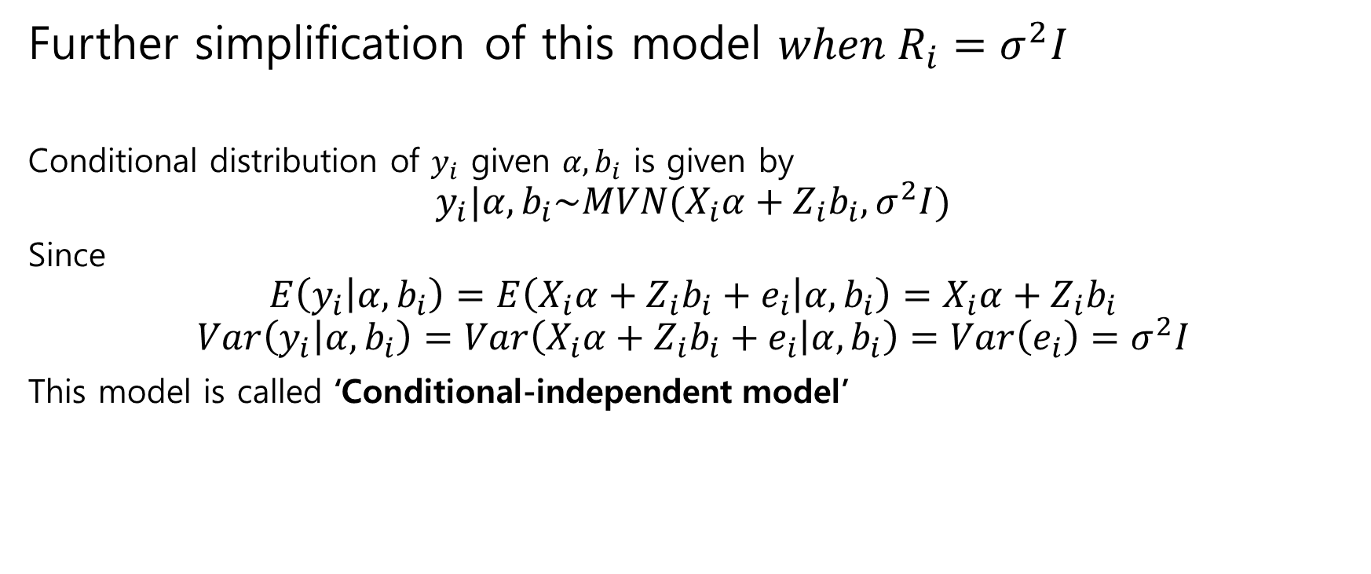
2.Models
Further simplification of this model $when R_{i}=σ^{2}I$
Conditional distribution of $y_{i}$ given $α,b_{i}$ is given by
$$y_{i}|α,b_{i}\sim MVN(X_{i}α+Z_{i}b_{i},σ^{2}I)$$
Since
$$E\left(y_{i} | α,b_{i}\right)=E\left(X_{i}α+Z_{i}b_{i}+e_{i} | α,b_{i}\right)=X_{i}α+Z_{i}b_{i}$$
$$Var\left(y_{i} | α,b_{i}\right)=Var\left(X_{i}α+Z_{i}b_{i}+e_{i} | α,b_{i}\right)=Var\left(e_{i}\right)=σ^{2}I$$
This model is called ‘Conditional-independent model’

Slide 16
2.Models
Inference for this general linear model is based on two following method
1st Least Square and Maximum Likelihood method
2nd Empirical Bayes methodology

Slide 17
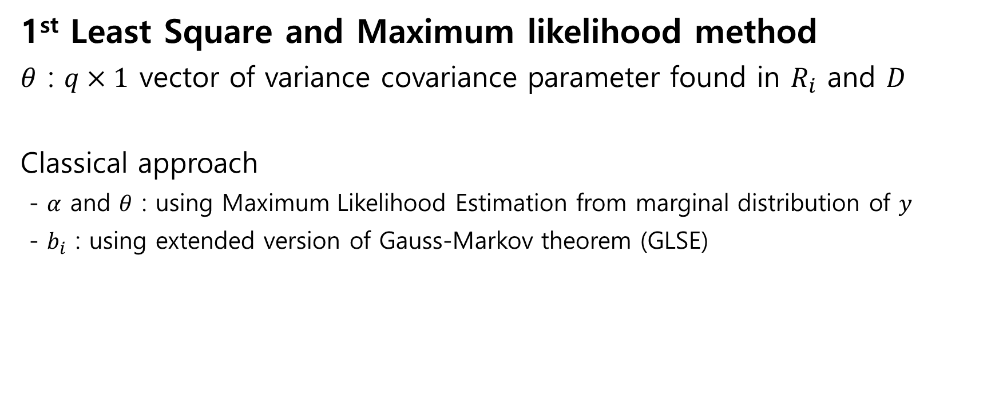
2.Models
1st Least Square and Maximum likelihood method
$θ$ : $q×1$ vector of variance covariance parameter found in $R_{i}$ and $D$
Classical approach
- $α$ and $θ$ : using Maximum Likelihood Estimation from marginal distribution of $y$
- $b_{i}$ : using extended version of Gauss-Markov theorem (GLSE)

Slide 18
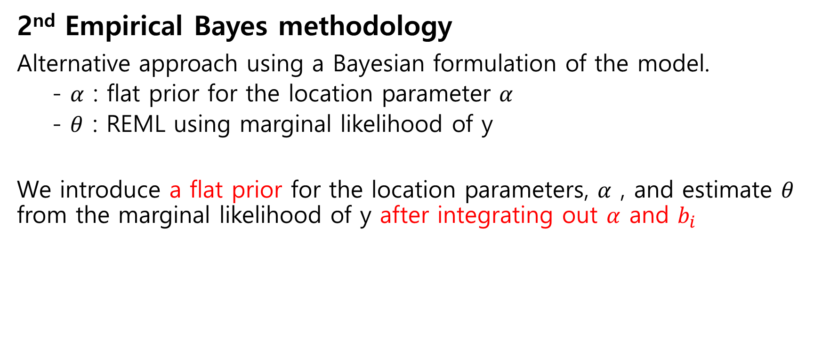
2.Models
2nd Empirical Bayes methodology
Alternative approach using a Bayesian formulation of the model.
- $α$ : flat prior for the location parameter $α$
- $θ$ : REML using marginal likelihood of y
We introduce a flat prior for the location parameters, $α$ , and estimate $θ$ from the marginal likelihood of y after integrating out $α$ and $b_{i}$

Slide 19
2.Models
2nd Empirical Bayes methodology
The Bayesian formulation provides both a conceptual and computational unity to the estimation method.
For either formulation, the EM algorithm provides a convenient approach to computation for random-effect models, since the individual characteristic can be viewed as missing data.

Slide 20
3. Estimation and Inference with Measured Response Data
1) Known Variance
2) Unknown Variance
3) Estimating the Covariance Matrix

Slide 21
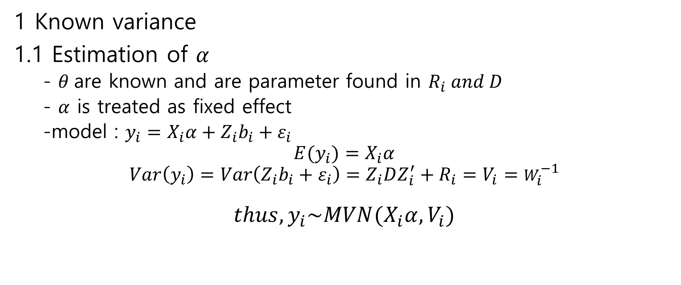
3.Estimation and Inference with Measured Response Data
1 Known variance
1.1 Estimation of $α$
- $θ$are known and are parameter found in $R_{i} and D$
- $α$ is treated as fixed effect
-model : $y_{i}=X_{i}α+Z_{i}b_{i}+ε_{i}$
$${E(y}_{i})=X_{i}α$$
$$Var\left(y_{i}\right)=Var\left(Z_{i}b_{i}+ε_{i}\right)=Z_{i}DZ_{i}^{′}+R_{i}=V_{i}=W_{i}^{−1}$$
$$thus, y_{i}\sim MVN(X_{i}α,V_{i})$$

Slide 22

3.Estimation and Inference with Measured Response Data
1.1 Estimation of $α$
$$y_{i}=X_{i}α+Z_{i}b_{i}+ε_{i}$$
$$=X_{i}α+ε_{i}^{∗}$$
$$where ε_{i}^{∗}=Z_{i}b_{i}+ε_{i}=\begin{matrix}{(Z}_{i} & I)\left(\begin{matrix}b_{i} \\ ε_{i}\end{matrix}\right)\end{matrix}, \left(\begin{matrix}b_{i} \\ ε_{i}\end{matrix}\right)\sim MVN\left(\left(\begin{matrix}0 \\ 0\end{matrix}\right),\left(\begin{matrix}D & 0 \\ 0 & R_{i}\end{matrix}\right)\right)$$
$${E(ε}_{i}^{∗})=\left(\begin{matrix}Z_{i} & I\end{matrix}\right)\left(\begin{matrix}0 \\ 0\end{matrix}\right)=\left(\begin{matrix}0 \\ 0\end{matrix}\right)$$
$$Var\left(ε_{i}^{∗}\right)=\left(\begin{matrix}Z_{i} & I\end{matrix}\right)\left(\begin{matrix}D & 0 \\ 0 & R_{i}\end{matrix}\right)\left(\begin{matrix}{Z_{i}}^{T} \\ I\end{matrix}\right)=Z_{i}D{Z_{i}}^{T}+R_{i}=V_{i}$$
$$i.e, ε_{i}^{∗}\sim MVN(0,V_{i})$$

Slide 23
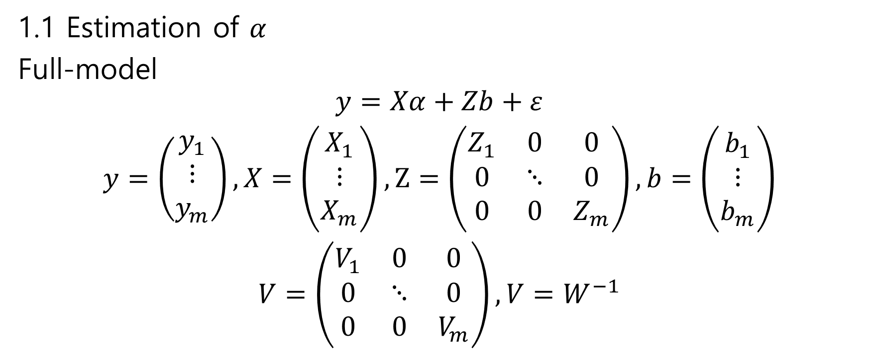
3.Estimation and Inference with Measured Response Data
1.1 Estimation of $α$
Full-model
$$y=Xα+Zb+ε$$
$$y=\left(\begin{matrix}y_{1} \\ ⋮ \\ y_{m}\end{matrix}\right), X=\left(\begin{matrix}X_{1} \\ ⋮ \\ X_{m}\end{matrix}\right), Z=\left(\begin{matrix}Z_{1} & 0 & 0 \\ 0 & ⋱ & 0 \\ 0 & 0 & Z_{m}\end{matrix}\right),b=\left(\begin{matrix}b_{1} \\ ⋮ \\ b_{m}\end{matrix}\right)$$
$$V=\left(\begin{matrix}V_{1} & 0 & 0 \\ 0 & ⋱ & 0 \\ 0 & 0 & V_{m}\end{matrix}\right), V=W^{−1}$$

Slide 24
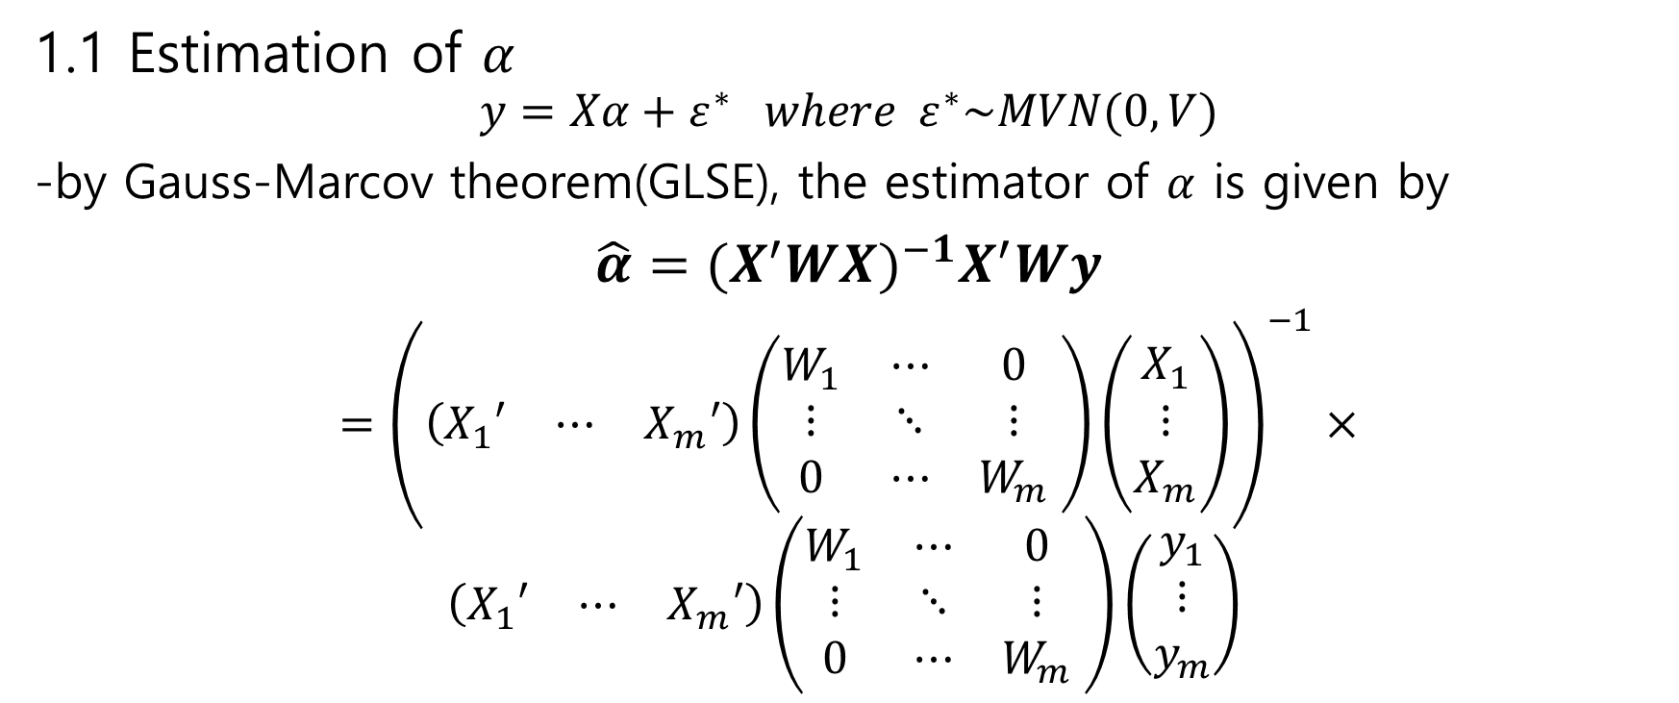
3.Estimation and Inference with Measured Response Data
1.1 Estimation of $α$
$$y=Xα+ε^{∗} where ε^{∗}\sim MVN(0,V)$$
-by Gauss-Marcov theorem(GLSE), the estimator of $α$ is given by
$$\hat{α}={(X^{′}WX)}^{−1}X^{′}Wy$$
$$={\left(\left(\begin{matrix}X_{1}′ & ⋯ & X_{m}′\end{matrix}\right)\left(\begin{matrix}W_{1} & ⋯ & 0 \\ ⋮ & ⋱ & ⋮ \\ 0 & ⋯ & W_{m}\end{matrix} \right)\left(\begin{matrix}X_{1} \\ ⋮ \\ X_{m}\end{matrix}\right)\right)}^{−1}×$$
$$\left(\begin{matrix}X_{1}′ & ⋯ & X_{m}′\end{matrix}\right)\left(\begin{matrix}W_{1} & ⋯ & 0 \\ ⋮ & ⋱ & ⋮ \\ 0 & ⋯ & W_{m}\end{matrix} \right)\left(\begin{matrix}y_{1} \\ ⋮ \\ y_{m}\end{matrix}\right)$$

Slide 25

3.Estimation and Inference with Measured Response Data
1.1 Estimation of $α$
$$\hat{α}={\left(\sum_{i=1}^{m}{X_{i}′W_{i}X_{i}}\right)}^{−1}\sum_{i=1}^{m}{X_{i}′W_{i}y_{i}}$$

Slide 26
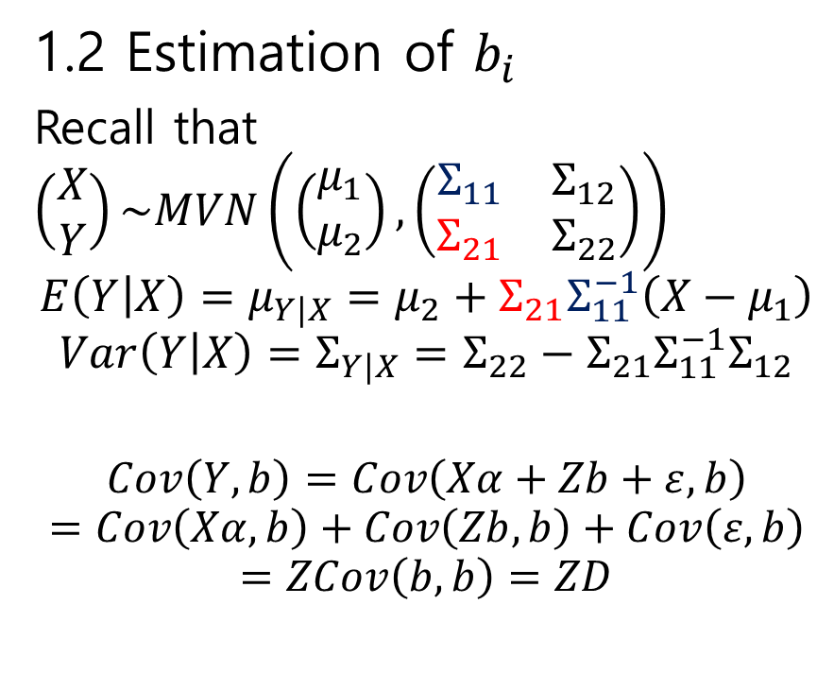

3.Estimation and Inference with Measured Response Data
1.2 Estimation of $b_{i}$
Recall that $\left(\begin{matrix}X \\ Y\end{matrix}\right)\sim MVN\left(\left(\begin{matrix}μ_{1} \\ μ_{2}\end{matrix}\right),\left(\begin{matrix}Σ_{11} & Σ_{12} \\ Σ_{21} & Σ_{22}\end{matrix}\right)\right)$
$$E\left(Y | X\right)=μ_{Y|X}=μ_{2}+Σ_{21}Σ_{11}^{−1}\left(X−μ_{1}\right)$$
$$Var\left(Y | X\right)=Σ_{Y|X}=Σ_{22}−Σ_{21}Σ_{11}^{−1}Σ_{12}$$
$$Cov\left(Y,b\right)=Cov\left(Xα+Zb+ε,b\right)$$
$$=Cov\left(Xα,b\right)+Cov\left(Zb,b\right)+Cov\left(ε,b\right)$$
$$=ZCov\left(b,b\right)=ZD$$
$$\left(\begin{matrix}Y \\ b\end{matrix}\right)\sim MVN\left(\left(\begin{matrix}Xα \\ 0\end{matrix}\right),\left(\begin{matrix}V & ZD \\ DZ′ & D\end{matrix}\right)\right)$$
Thus $E\left(b | Y\right)=0+DZ′V^{−1}(Y−Xα)$

Slide 27

3.Estimation and Inference with Measured Response Data
1.2 Estimation of $b_{i}$
$$Finally, \hat{b_{i}}={DZ}_{i}^{′}W_{i}\left(y_{i}−X_{i}\hat{α}\right)$$
$\hat{b_{i}}$ is called the ‘Best Linear Unbiased Predictor’

Slide 28
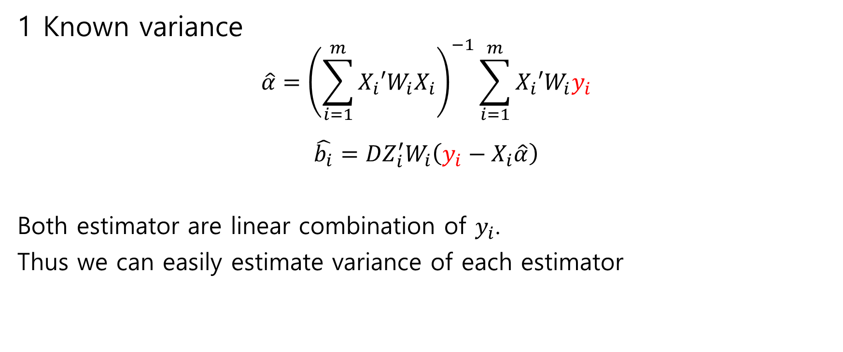
3.Estimation and Inference with Measured Response Data
1 Known variance
$$\hat{α}={\left(\sum_{i=1}^{m}{X_{i}′W_{i}X_{i}}\right)}^{−1}\sum_{i=1}^{m}{X_{i}′W_{i}y_{i}}$$
$$\hat{b_{i}}={DZ}_{i}^{′}W_{i}\left(y_{i}−X_{i}\hat{α}\right)$$
Both estimator are linear combination of $y_{i}$.
Thus we can easily estimate variance of each estimator

Slide 29
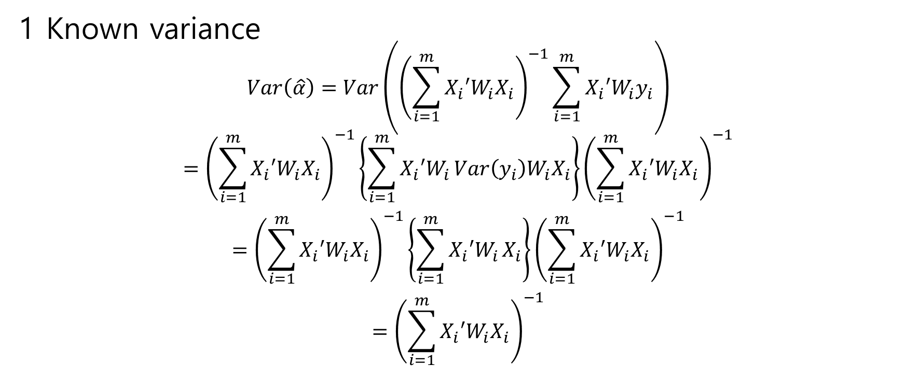
3.Estimation and Inference with Measured Response Data
1 Known variance
$$Var\left(\hat{α}\right)=Var\left({\left(\sum_{i=1}^{m}{X_{i}′W_{i}X_{i}}\right)}^{−1}\sum_{i=1}^{m}{X_{i}′W_{i}y_{i}}\right)$$
$$={\left(\sum_{i=1}^{m}{X_{i}′W_{i}X_{i}}\right)}^{−1}\left\{\sum_{i=1}^{m}{X_{i}′W_{i}}Var\left(y_{i}\right)W_{i}X_{i}\right\}{\left(\sum_{i=1}^{m}{X_{i}′W_{i}X_{i}}\right)}^{−1}$$
$$={\left(\sum_{i=1}^{m}{X_{i}′W_{i}X_{i}}\right)}^{−1}\left\{\sum_{i=1}^{m}{X_{i}′W_{i}}X_{i}\right\}{\left(\sum_{i=1}^{m}{X_{i}′W_{i}X_{i}}\right)}^{−1}$$
$$={\left(\sum_{i=1}^{m}{X_{i}′W_{i}X_{i}}\right)}^{−1}$$

Slide 30
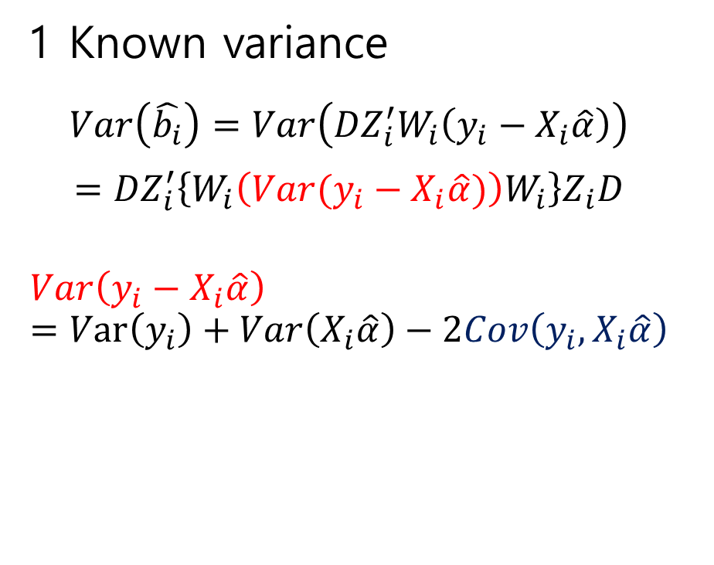
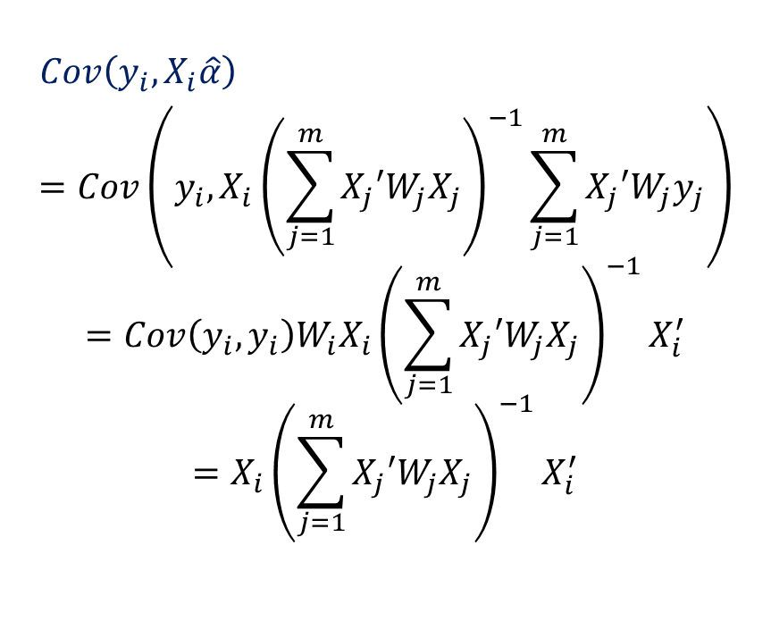
3.Estimation and Inference with Measured Response Data
1 Known variance
$$Var\left(\hat{b_{i}}\right)=Var\left({DZ}_{i}^{′}W_{i}\left(y_{i}−X_{i}\hat{α}\right)\right)$$
$$={DZ}_{i}^{′}\left\{W_{i}\left(Var(y_{i}−X_{i}\hat{α})\right)W_{i}\right\}Z_{i}D$$
$$Var\left(y_{i}−X_{i}\hat{α}\right)=Var\left(y_{i}\right)+Var\left(X_{i}\hat{α}\right)−2Cov\left(y_{i},X_{i}\hat{α}\right)$$
$Cov\left(y_{i},X_{i}\hat{α}\right)$
$$=Cov\left(y_{i},X_{i}{\left(\sum_{j=1}^{m}{X_{j}′W_{j}X_{j}}\right)}^{−1}\sum_{j=1}^{m}{X_{j}′W_{j}y_{j}}\right)$$
$$=Cov\left(y_{i}, y_{i}\right)W_{i}X_{i}{\left(\sum_{j=1}^{m}{X_{j}′W_{j}X_{j}}\right)}^{−1}X_{i}^{′}$$
$$=X_{i}{\left(\sum_{j=1}^{m}{X_{j}′W_{j}X_{j}}\right)}^{−1}X_{i}^{′}$$

Slide 31
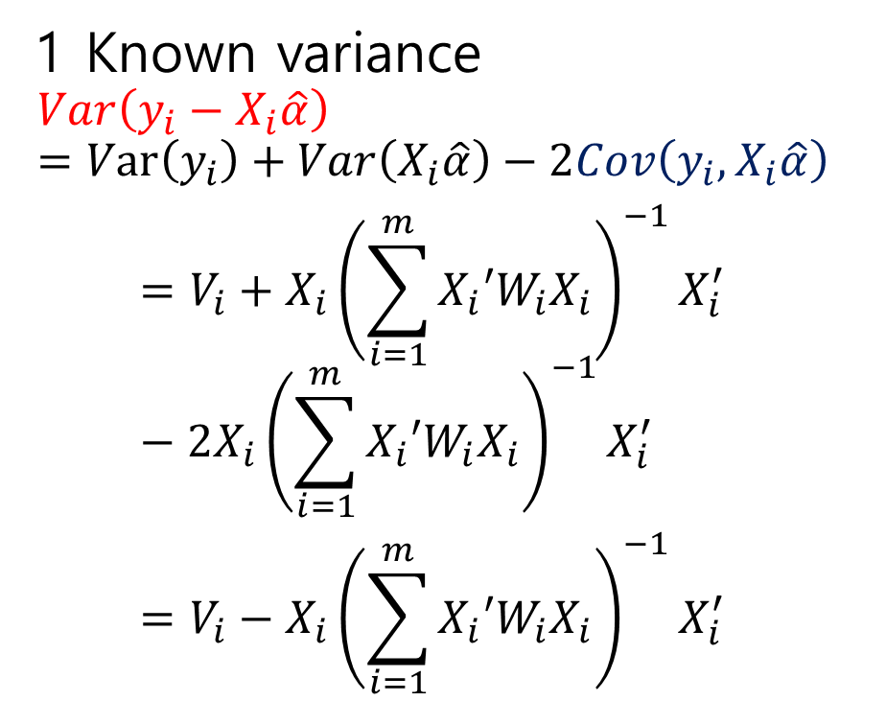
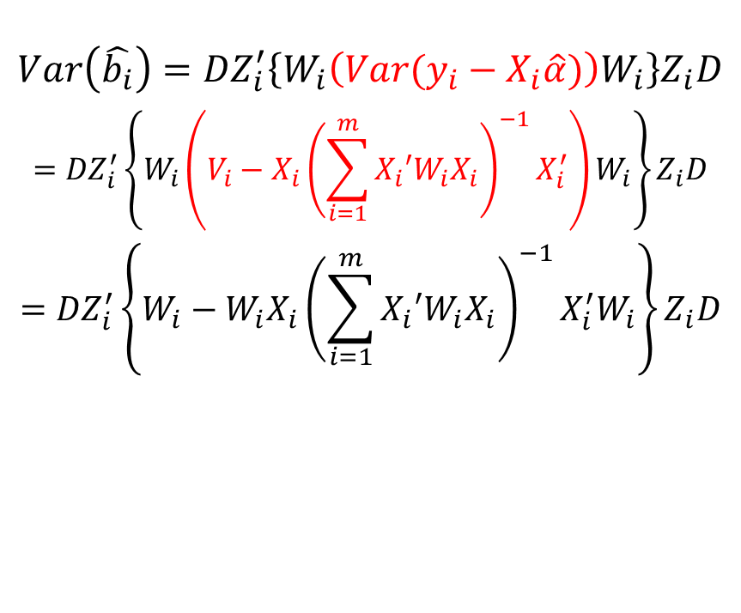
3.Estimation and Inference with Measured Response Data
1 Known variance
$$Var\left(y_{i}−X_{i}\hat{α}\right)=Var\left(y_{i}\right)+Var\left(X_{i}\hat{α}\right)−2Cov\left(y_{i},X_{i}\hat{α}\right)$$
$$=V_{i}+X_{i}{\left(\sum_{i=1}^{m}{X_{i}′W_{i}X_{i}}\right)}^{−1}X_{i}^{′}−2X_{i}{\left(\sum_{i=1}^{m}{X_{i}′W_{i}X_{i}}\right)}^{−1}X_{i}^{′}$$
$$=V_{i}−X_{i}{\left(\sum_{i=1}^{m}{X_{i}′W_{i}X_{i}}\right)}^{−1}X_{i}^{′}$$
$$Var\left(\hat{b_{i}}\right)={DZ}_{i}^{′}\left\{W_{i}\left(Var(y_{i}−X_{i}\hat{α})\right)W_{i}\right\}Z_{i}D$$
$$={DZ}_{i}^{′}\left\{W_{i}\left(V_{i}−X_{i}{\left(\sum_{i=1}^{m}{X_{i}′W_{i}X_{i}}\right)}^{−1}X_{i}^{′}\right)W_{i}\right\}Z_{i}D$$
$$={DZ}_{i}^{′}\left\{W_{i}−W_{i}X_{i}{\left(\sum_{i=1}^{m}{X_{i}′W_{i}X_{i}}\right)}^{−1}X_{i}^{′}W_{i}\right\}Z_{i}D$$

Slide 32
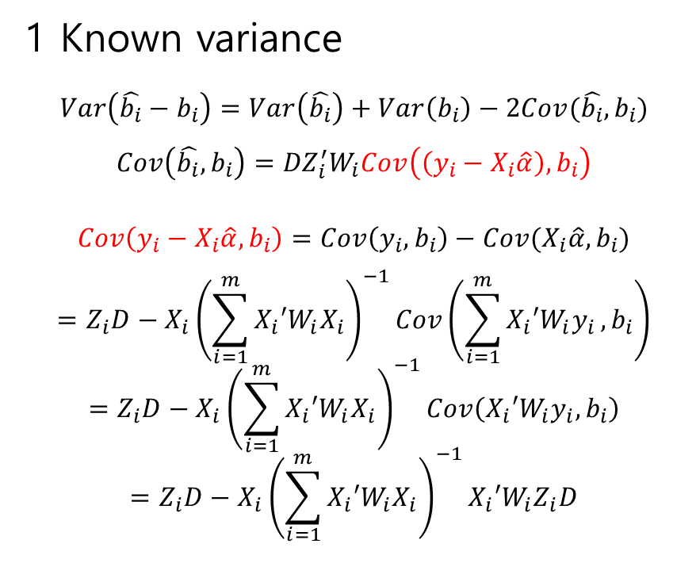
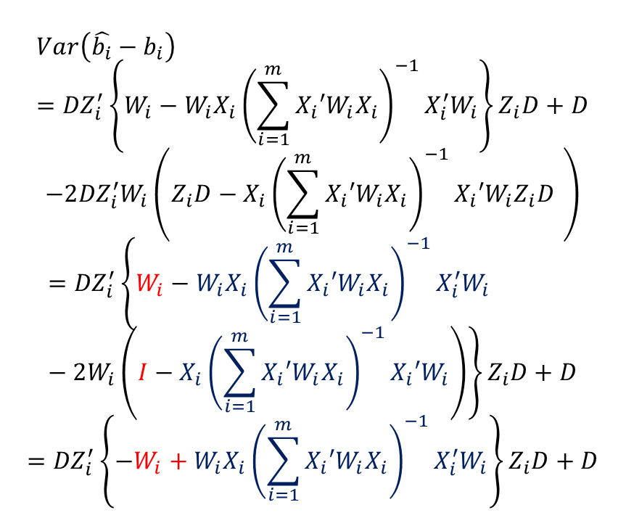
3.Estimation and Inference with Measured Response Data
1 Known variance
$$Var\left(\hat{b_{i}}−b_{i}\right)=Var\left(\hat{b_{i}}\right)+Var\left(b_{i}\right)−2Cov(\hat{b_{i}},b_{i})$$
$$Cov\left(\hat{b_{i}},b_{i}\right)={DZ}_{i}^{′}W_{i}Cov\left(\left(y_{i}−X_{i}\hat{α}\right),b_{i}\right)$$
$$Cov\left(y_{i}−X_{i}\hat{α},b_{i}\right)=Cov\left(y_{i},b_{i}\right)−Cov(X_{i}\hat{α},b_{i})$$
$$=Z_{i}D−X_{i}{\left(\sum_{i=1}^{m}{X_{i}′W_{i}X_{i}}\right)}^{−1}Cov\left(\sum_{i=1}^{m}{X_{i}′W_{i}y_{i}},b_{i}\right)$$
$$=Z_{i}D−X_{i}{\left(\sum_{i=1}^{m}{X_{i}′W_{i}X_{i}}\right)}^{−1}Cov\left(X_{i}′W_{i}y_{i},b_{i}\right)$$
$$=Z_{i}D−X_{i}{\left(\sum_{i=1}^{m}{X_{i}′W_{i}X_{i}}\right)}^{−1}X_{i}′W_{i}Z_{i}D$$
$$Var\left(\hat{b_{i}}−b_{i}\right)={DZ}_{i}^{′}\left\{W_{i}−W_{i}X_{i}{\left(\sum_{i=1}^{m}{X_{i}′W_{i}X_{i}}\right)}^{−1}X_{i}^{′}W_{i}\right\}Z_{i}D+D$$
$$−2{DZ}_{i}^{′}W_{i}\left(Z_{i}D−X_{i}{\left(\sum_{i=1}^{m}{X_{i}′W_{i}X_{i}}\right)}^{−1}X_{i}′W_{i}Z_{i}D \right)$$
$$={DZ}_{i}^{′}\left\{W_{i}−W_{i}X_{i}{\left(\sum_{i=1}^{m}{X_{i}′W_{i}X_{i}}\right)}^{−1}X_{i}^{′}W_{i}−2W_{i}\left(I−X_{i}{\left(\sum_{i=1}^{m}{X_{i}′W_{i}X_{i}}\right)}^{−1}X_{i}′W_{i}\right)\right\}Z_{i}D+D$$
$$={DZ}_{i}^{′}\left\{−W_{i}+W_{i}X_{i}{\left(\sum_{i=1}^{m}{X_{i}′W_{i}X_{i}}\right)}^{−1}X_{i}^{′}W_{i}\right\}Z_{i}D+D$$

Slide 33
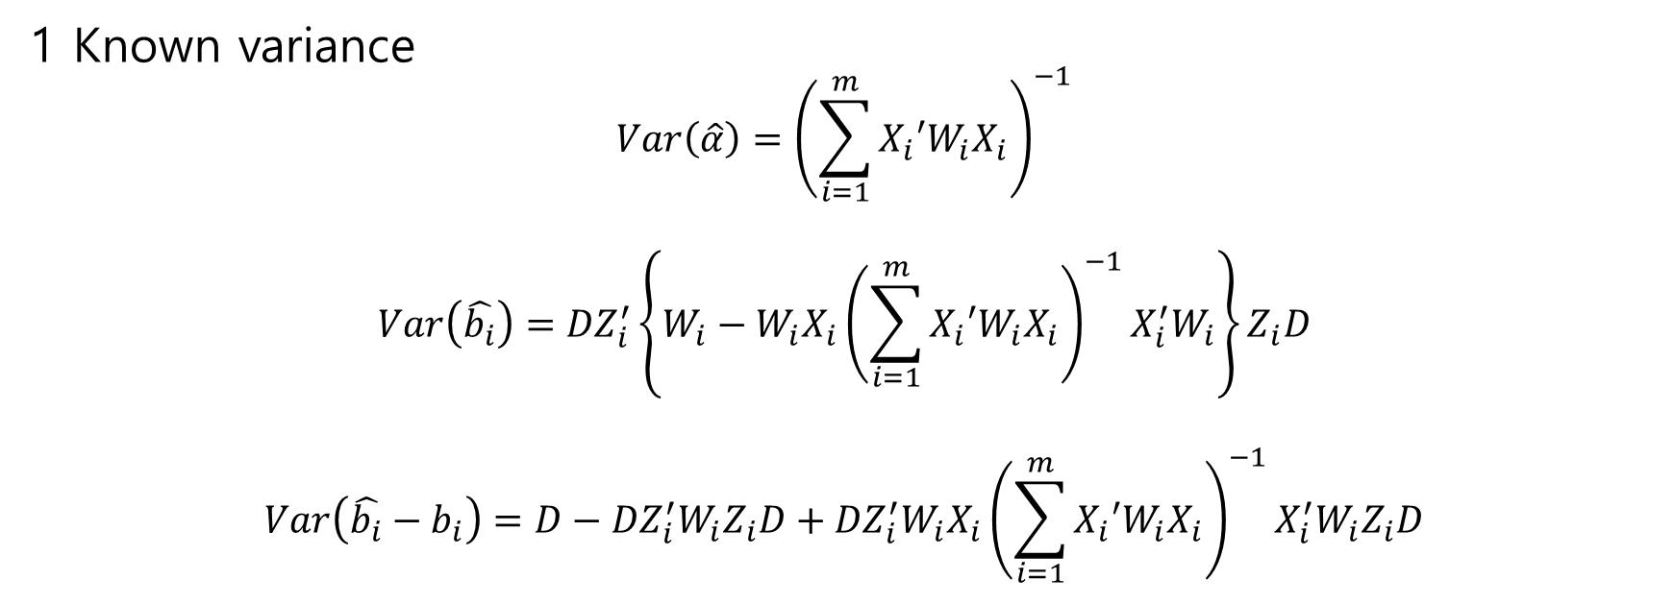
3.Estimation and Inference with Measured Response Data
1 Known variance
$$Var\left(\hat{α}\right)={\left(\sum_{i=1}^{m}{X_{i}′W_{i}X_{i}}\right)}^{−1}$$
$$Var\left(\hat{b_{i}}\right)={DZ}_{i}^{′}\left\{W_{i}−W_{i}X_{i}{\left(\sum_{i=1}^{m}{X_{i}′W_{i}X_{i}}\right)}^{−1}X_{i}^{′}W_{i}\right\}Z_{i}D$$
$$Var\left(\hat{b_{i}}−b_{i}\right)=D−{DZ}_{i}^{′}W_{i}Z_{i}D+{DZ}_{i}^{′}W_{i}X_{i}{\left(\sum_{i=1}^{m}{X_{i}′W_{i}X_{i}}\right)}^{−1}X_{i}^{′}W_{i}Z_{i}D$$

Slide 34
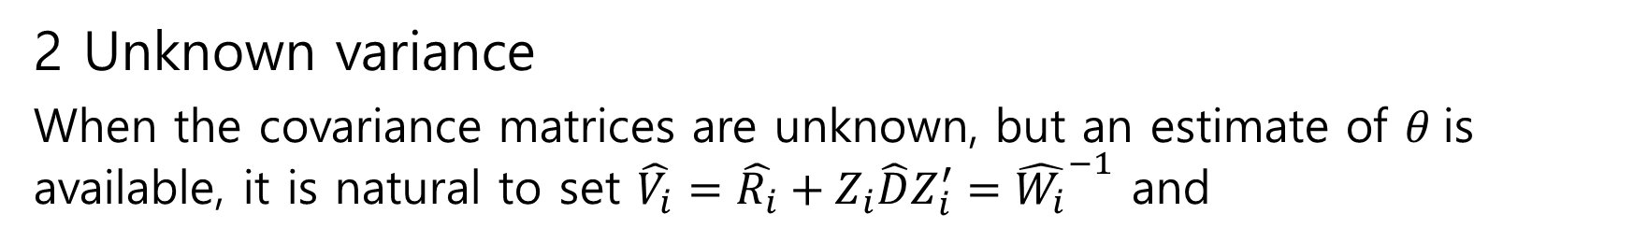
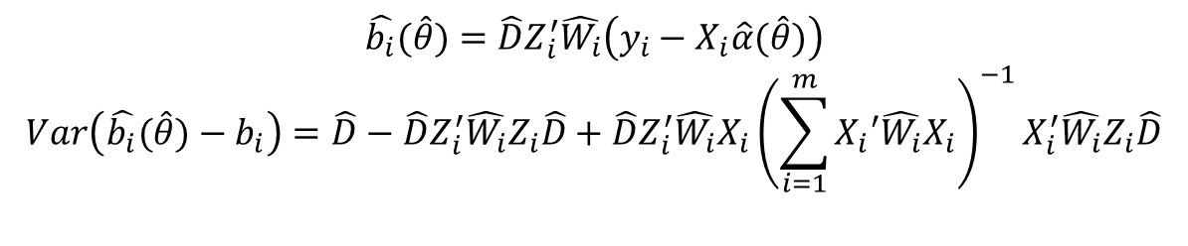
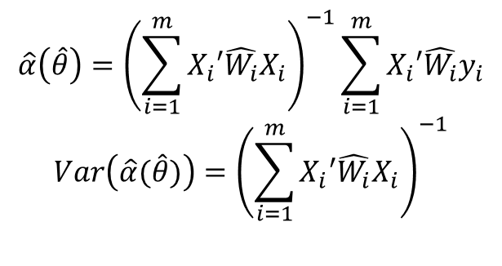
3.Estimation and Inference with Measured Response Data
2 Unknown variance
When the covariance matrices are unknown, but an estimate of $θ$is available, it is natural to set $\hat{V_{i}}=\hat{R_{i}}+Z_{i}\hat{D}Z_{i}^{′}={\hat{W_{i}}}^{−1}$ and
$$\hat{α}\left(\hat{θ}\right)={\left(\sum_{i=1}^{m}{X_{i}′\hat{W_{i}}X_{i}}\right)}^{−1}\sum_{i=1}^{m}{X_{i}′\hat{W_{i}}y_{i}}$$
$$Var\left(\hat{α}(\hat{θ})\right)={\left(\sum_{i=1}^{m}{X_{i}′\hat{W_{i}}X_{i}}\right)}^{−1}$$
$$\hat{b_{i}}(\hat{θ})={\hat{D}Z}_{i}^{′}\hat{W_{i}}\left(y_{i}−X_{i}\hat{α}(\hat{θ})\right)$$
$$Var\left( \hat{b_{i}}(\hat{θ})−b_{i}\right)=\hat{D}−{\hat{D}Z}_{i}^{′}\hat{W_{i}}Z_{i}\hat{D}+{\hat{D}Z}_{i}^{′}\hat{W_{i}}X_{i}{\left(\sum_{i=1}^{m}{X_{i}′\hat{W_{i}}X_{i}}\right)}^{−1}X_{i}^{′}\hat{W_{i}}Z_{i}\hat{D}$$

Slide 35
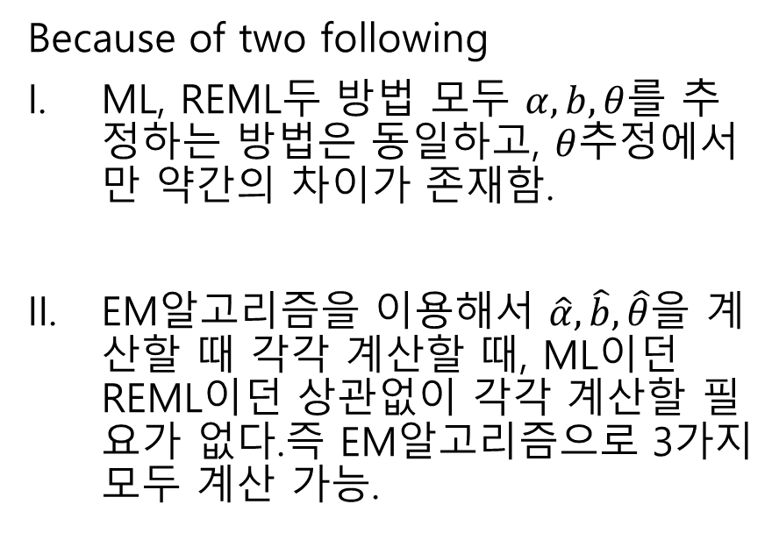
3.Estimation and Inference with Measured Response Data
3 Estimating the Covariance
Here we focus on two competitive estimates
ML estimate
REML(restricted ML, residual ML)
Because of two following
ML, REML두 방법 모두 $α,b, θ$를 추정하는 방법은 동일하고, $θ$추정에서만 약간의 차이가 존재함.
EM알고리즘을 이용해서 $\hat{α}, \hat{b},\hat{θ}을$ 계산할 때 각각 계산할 때, ML이던 REML이던 상관없이 각각 계산할 필요가 없다.즉 EM알고리즘으로 3가지 모두 계산 가능.

Slide 36
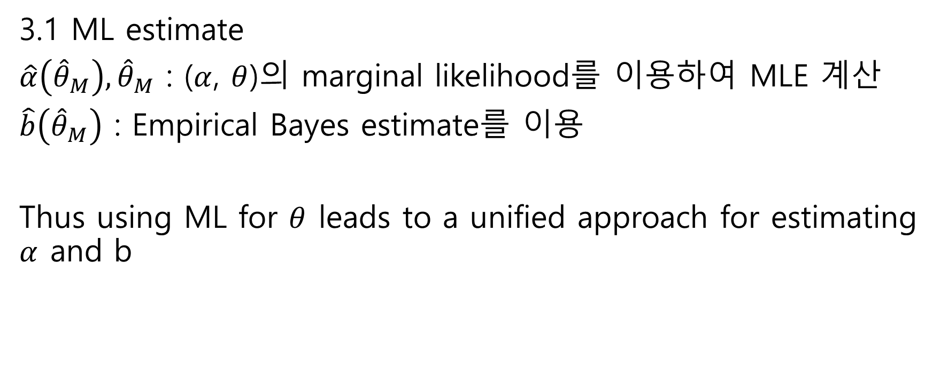
3.Estimation and Inference with Measured Response Data
3.1 ML estimate
$\hat{α}\left({\hat{θ}}_{M}\right),{\hat{θ}}_{M}$ : ($α$, $θ$)의 marginal likelihood를 이용하여 MLE 계산
$\hat{b}\left({\hat{θ}}_{M}\right)$ : Empirical Bayes estimate를 이용
Thus using ML for $θ$ leads to a unified approach for estimating $α$ and b

Slide 37
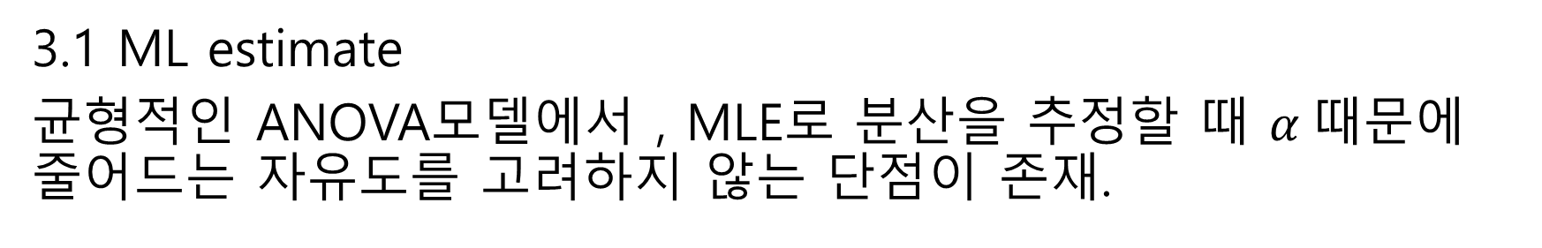
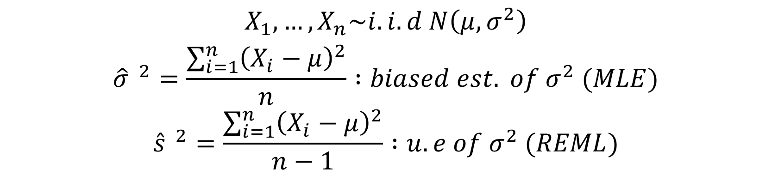
3.Estimation and Inference with Measured Response Data
3.1 ML estimate
균형적인 ANOVA모델에서 , MLE로 분산을 추정할 때 $α$때문에 줄어드는 자유도를 고려하지 않는 단점이 존재.
$$X_{1},…,X_{n}\sim i.i.d N\left(μ,σ^{2}\right)$$
$${\hat{σ} }^{2}=\frac{\sum_{i=1}^{n}{{\left(X_{i}−μ\right)}^{2}}}{n} :biased est. of σ^{2} (MLE)$$
$${\hat{s} }^{2}=\frac{\sum_{i=1}^{n}{{\left(X_{i}−μ\right)}^{2}}}{n−1} :u.e of σ^{2} (REML)$$

Slide 38
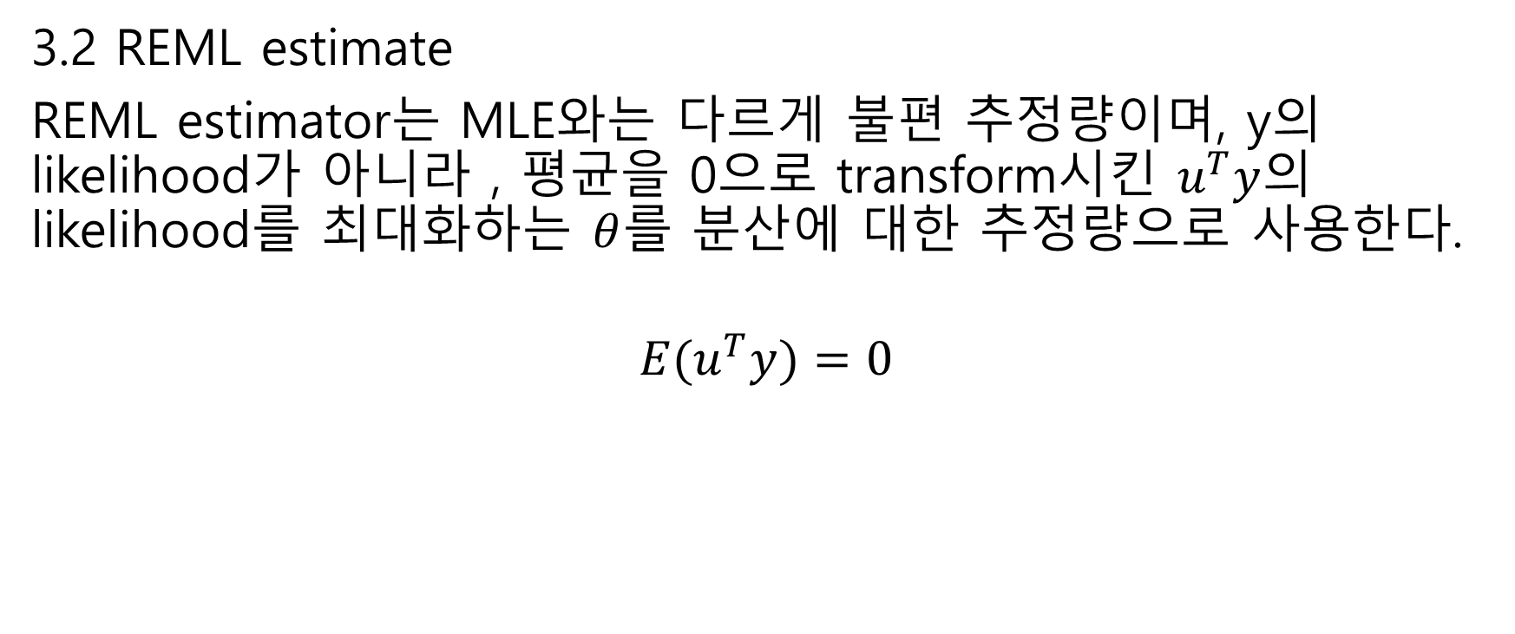
3.Estimation and Inference with Measured Response Data
3.2 REML estimate
REML estimator는 MLE와는 다르게 불편 추정량이며, y의likelihood가 아니라 , 평균을 0으로 transform시킨 $u^{T}y$의 likelihood를 최대화하는 $θ$를 분산에 대한 추정량으로 사용한다.
$${E(u}^{T}y)=0$$

Slide 39
3.Estimation and Inference with Measured Response Data
3.2 REML estimate
1st Relying on the sampling theoretic arguments
2nd Bayesian approach

Slide 40
3.Estimation and Inference with Measured Response Data
3.2 REML estimate
Bayesian approach leads to the unified treatment of estimation and computation.
And it leads to a simplified derivation of the likelihood equations and shows how to handle their computation.

Slide 41
4. Using the EM algorithm for ML estimation

Slide 42
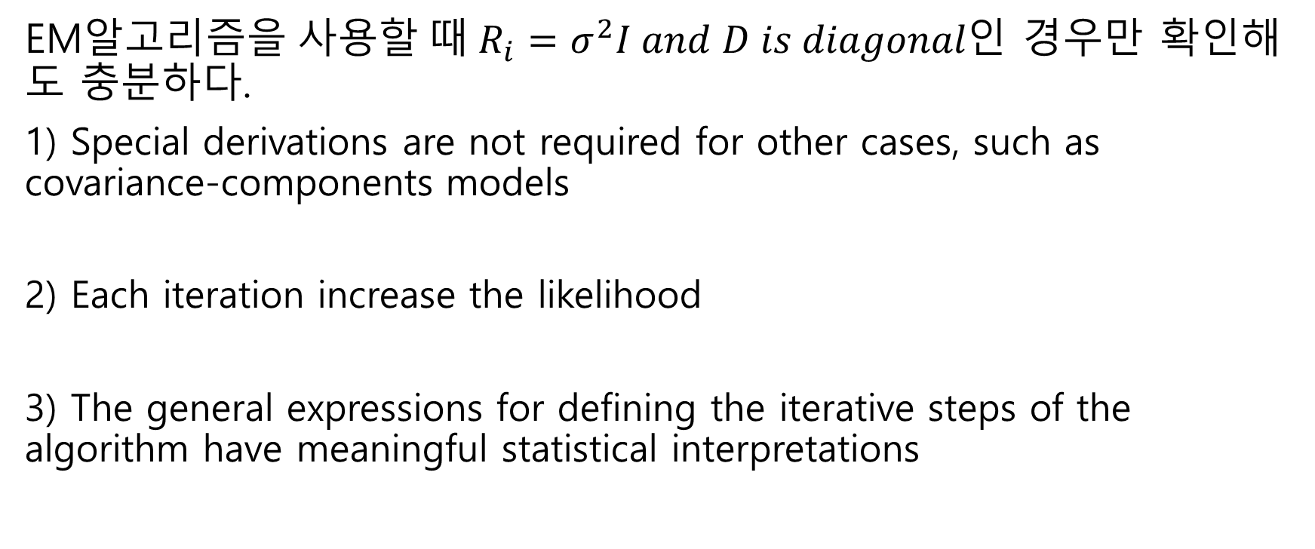
4.Using the EM algorithm for ML estimation
EM알$고리즘을 사용할 때 R_{i}=σ^{2}I and D is diagonal인$ 경우만 확인해도 충분하다.
1) Special derivations are not required for other cases, such as covariance-components models
2) Each iteration increase the likelihood
3) The general expressions for defining the iterative steps of the algorithm have meaningful statistical interpretations

Slide 43

4.Using the EM algorithm for ML estimation
When $R_{i}=σ^{2}I$ and $D is an k×k n.n.d matrix$
we would use
$${\hat{σ}}^{2}=\frac{\sum_{i=1}^{m}{e_{i}′e_{i}}}{\sum_{i=1}^{m}{n_{i}}}=\frac{t_{1}}{\sum_{i=1}^{m}{n_{i}}}$$
$$\hat{D}=\frac{\sum_{i=1}^{m}{b_{i}b_{i}′}}{m}=\frac{t_{2}}{m}$$

Slide 44
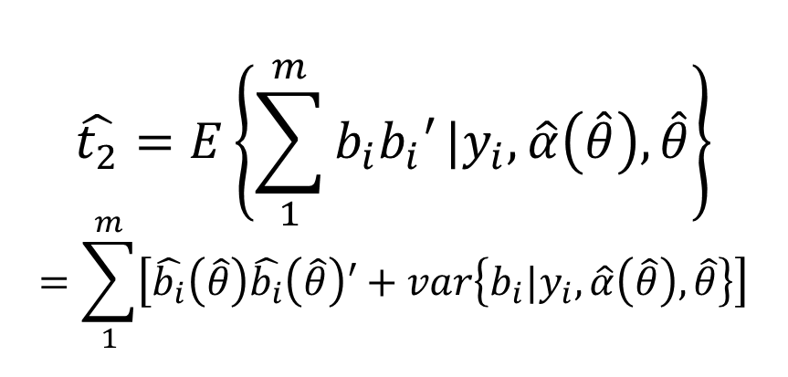
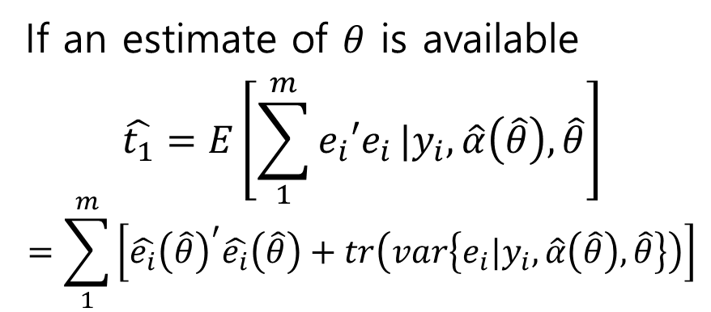
4.Using the EM algorithm for ML estimation
If an estimate of $θ$ is available
$$\hat{t_{1}}=E\left[\sum_{1}^{m}{e_{i}′e_{i}}|y_{i},\hat{α}\left(\hat{θ}\right),\hat{θ}\right]$$
$$=\sum_{1}^{m}{\left[{\hat{e_{i}}\left(\hat{θ}\right)}^{′}\hat{e_{i}}\left(\hat{θ}\right)+tr\left(var\left\{e_{i}|y_{i},\hat{α}\left(\hat{θ}\right),\hat{θ}\right\}\right)\right]}$$
$$\hat{t_{2}}=E\left\{\sum_{1}^{m}{b_{i}b_{i}′}|y_{i},\hat{α}\left(\hat{θ}\right),\hat{θ}\right\}$$
$$=\sum_{1}^{m}{\left[\hat{b_{i}}\left(\hat{θ}\right)\hat{b_{i}}\left(\hat{θ}\right)′+var\left\{b_{i}|y_{i},\hat{α}\left(\hat{θ}\right),\hat{θ}\right\}\right]}$$
$$where \hat{e_{i}}\left(\hat{θ}\right)=E\left(e_{i} | y_{i},\hat{α}\left(\hat{θ}\right),\hat{θ}\right)=y_{i}−X\hat{α}\left(\hat{θ}\right)−Z_{i}\hat{b_{i}}\left(\hat{θ}\right)$$

Slide 45
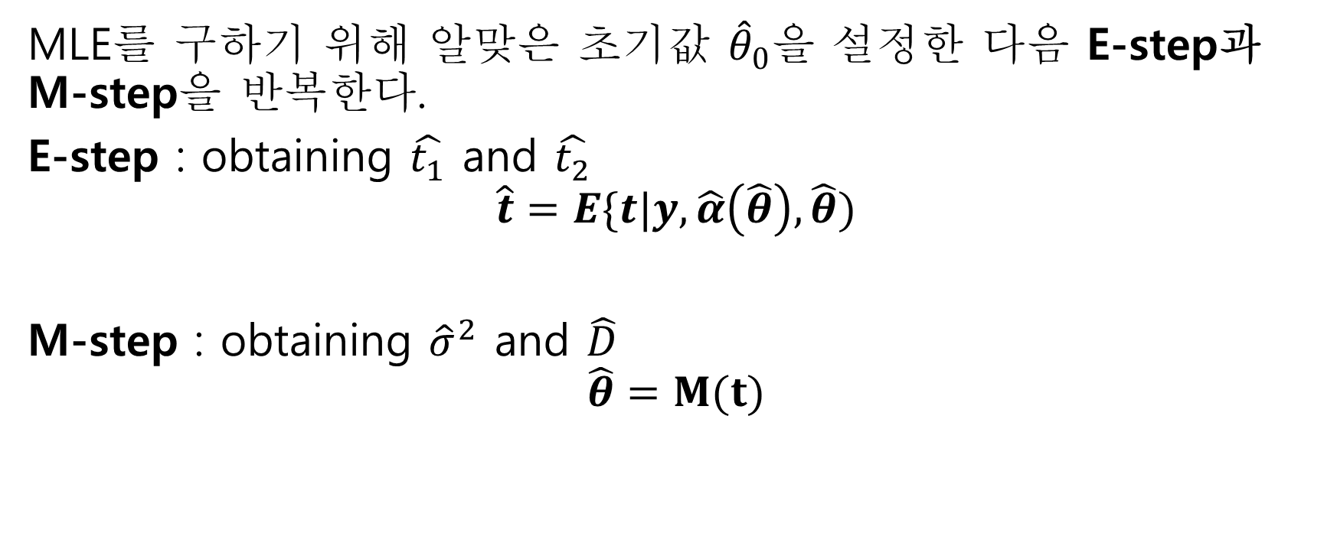
4.Using the EM algorithm for ML estimation
MLE를 구하기 위해 알맞은 초기값 ${\hat{θ}}_{0}$을 설정한 다음 E-step과 M-step을 반복한다.
E-step : obtaining $\hat{t_{1}}$ and $\hat{t_{2}}$
$$\hat{t}=E\{t|y,\hat{α}\left(\hat{θ}\right),\hat{θ})$$
M-step : obtaining ${\hat{σ}}^{2}$ and $\hat{D}$
$$\hat{θ}=M(t)$$

Slide 46
5. REML Estimation and Computation

Slide 47
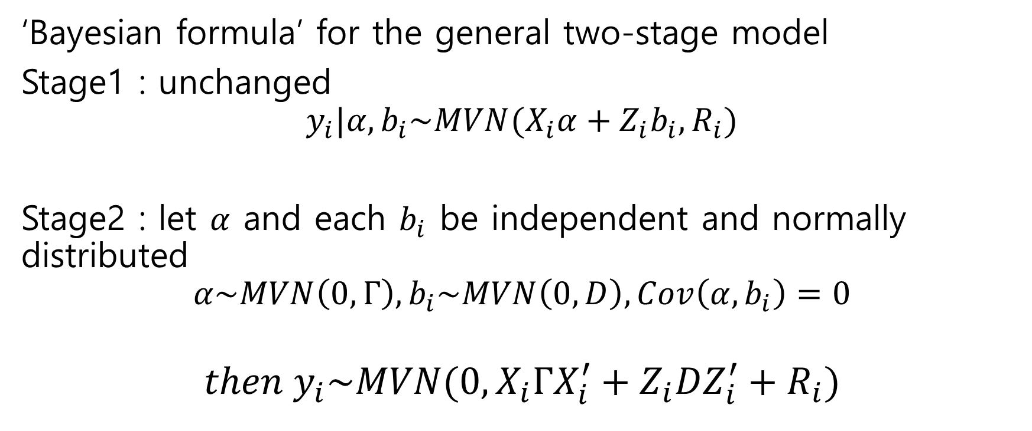
5.REML Estimation and Computation
‘Bayesian formula’ for the general two-stage model
Stage1 : unchanged
$$y_{i}|α,b_{i}\sim MVN(X_{i}α+Z_{i}b_{i},R_{i})$$
Stage2 : let $α$ and each $b_{i}$ be independent and normally distributed
$$α\sim MVN\left(0, Γ\right), b_{i}\sim MVN\left(0,D\right), Cov\left(α,b_{i}\right)=0$$
$$then y_{i}\sim MVN(0,X_{i}ΓX_{i}^{′}+Z_{i}DZ_{i}^{′}+R_{i})$$

Slide 48
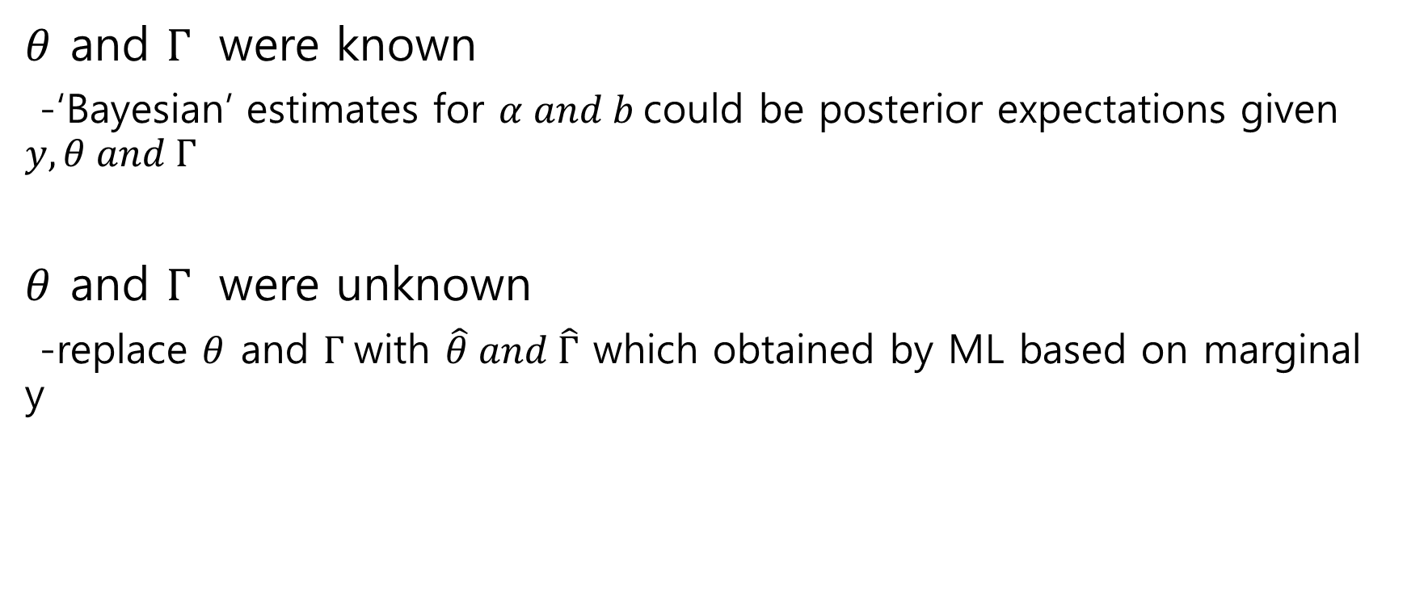
5.REML Estimation and Computation
$θ$ and $Γ$ were known
-‘Bayesian’ estimates for $α and b$could be posterior expectations given $y,θ and Γ$
$θ$ and $Γ$ were unknown
-replace $θ$ and $Γ$with $\hat{θ} and \hat{Γ}$ which obtained by ML based on marginal y

Slide 49
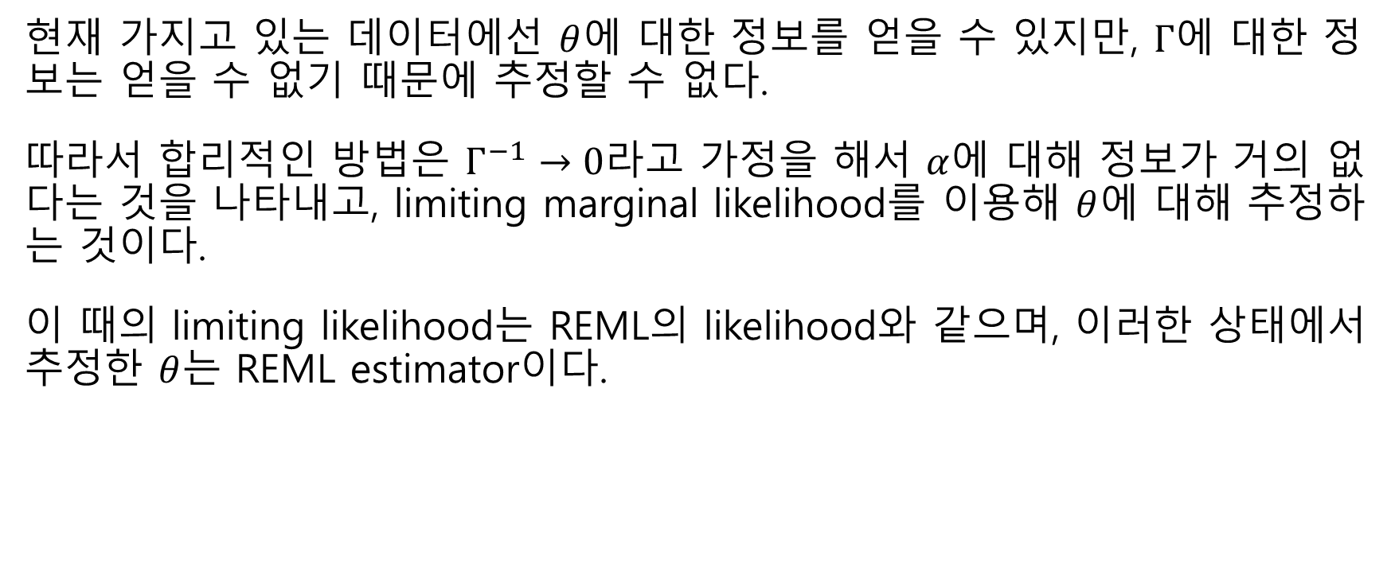
5.REML Estimation and Computation
현재 가지고 있는 데이터에선 $θ$에 대한 정보를 얻을 수 있지만, $Γ$에 대한 정보는 얻을 수 없기 때문에 추정할 수 없다.
따라서 합리적인 방법은 $Γ^{−1}→0$라고 가정을 해서 $α$에 대해 정보가 거의 없다는 것을 나타내고, limiting marginal likelihood를 이용해 $θ$에 대해 추정하는 것이다.
이 때의 limiting likelihood는 REML의 likelihood와 같으며, 이러한 상태에서 추정한 $θ$는 REML estimator이다.

Slide 50
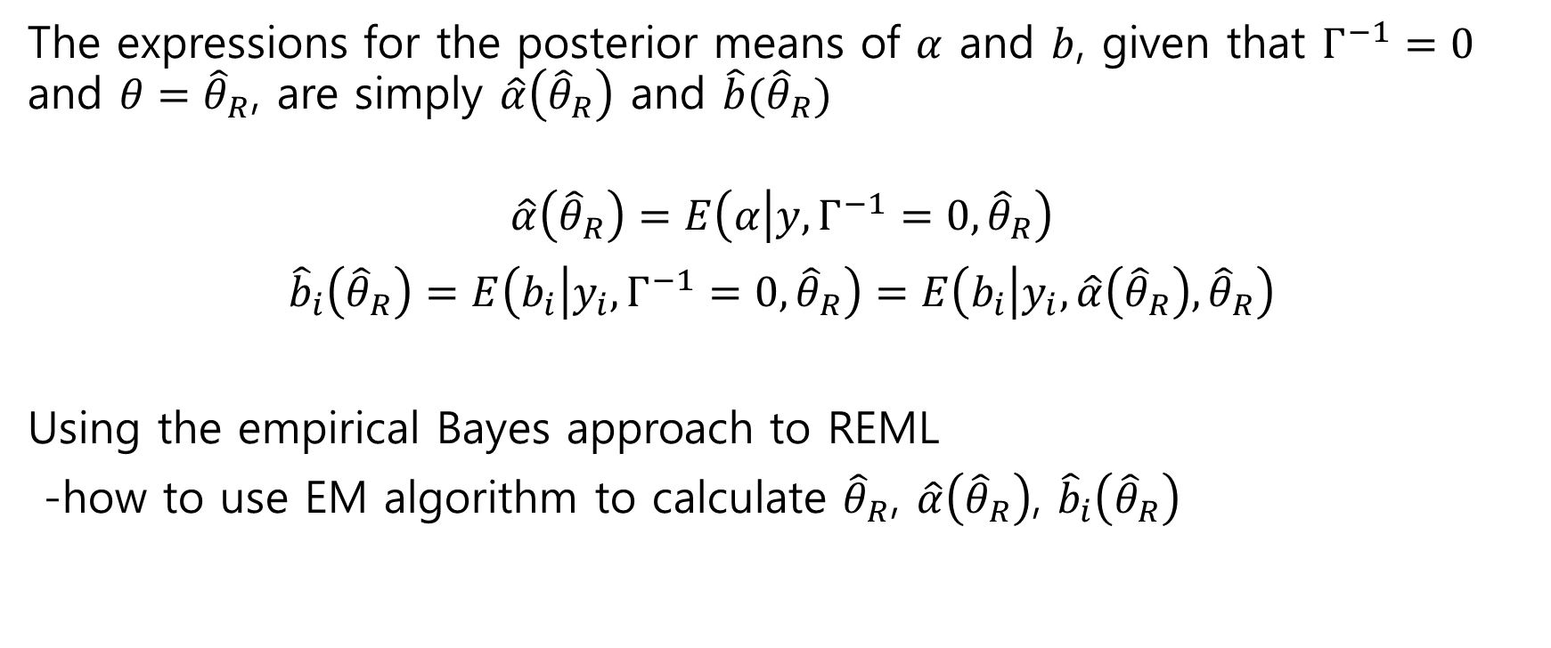
5.REML Estimation and Computation
The expressions for the posterior means of $α$ and $b$, given that $Γ^{−1}=0$ and $θ={\hat{θ}}_{R}$, are simply $\hat{α}\left({\hat{θ}}_{R}\right)$ and $\hat{b}({\hat{θ}}_{R})$
$$\hat{α}\left({\hat{θ}}_{R}\right)=E\left(α | y,Γ^{−1}=0,{\hat{θ}}_{R}\right)$$
$${\hat{b}}_{i}\left({\hat{θ}}_{R}\right)=E\left(b_{i} | y_{i},Γ^{−1}=0,{\hat{θ}}_{R}\right)=E\left(b_{i} | y_{i},\hat{α}\left({\hat{θ}}_{R}\right),{\hat{θ}}_{R}\right)$$
Using the empirical Bayes approach to REML
-how to use EM algorithm to calculate ${\hat{θ}}_{R}$, $\hat{α}\left({\hat{θ}}_{R}\right)$, ${\hat{b}}_{i}\left({\hat{θ}}_{R}\right)$

Slide 51
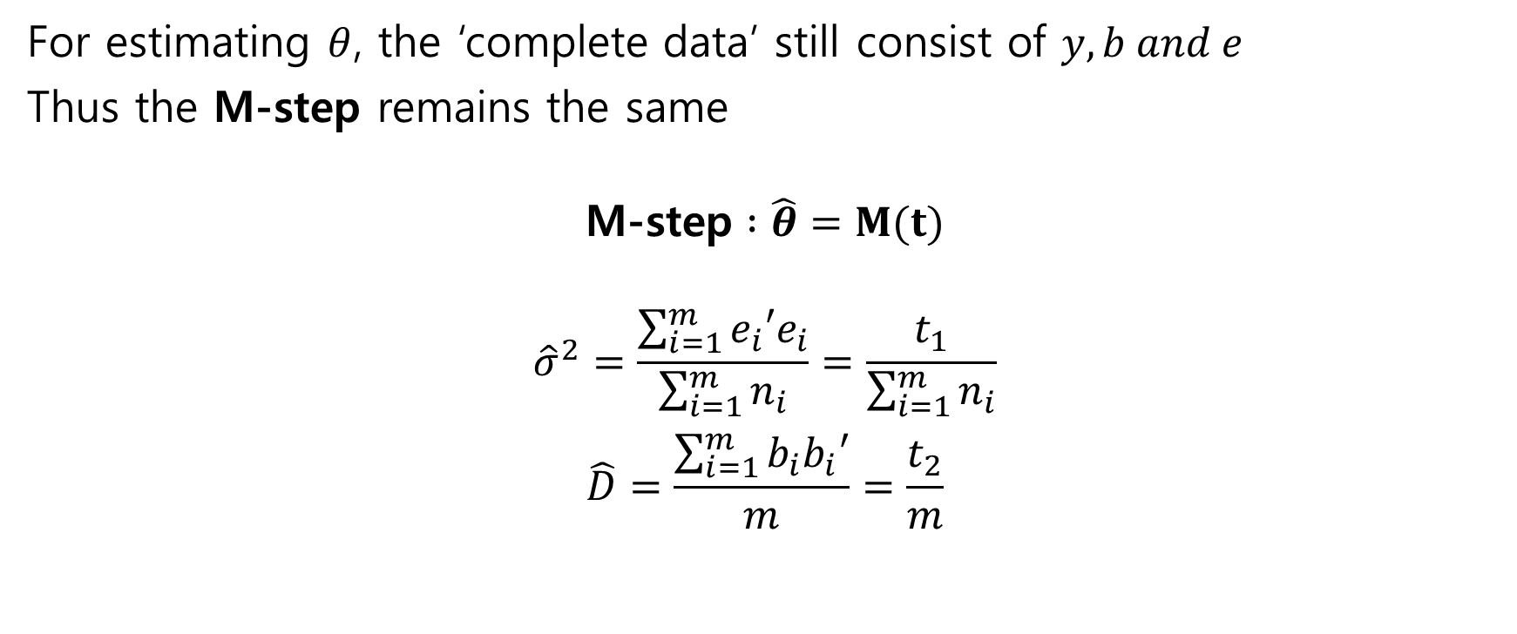
5.REML Estimation and Computation
For estimating $θ$, the ‘complete data’ still consist of $y,b and e$
Thus the M-step remains the same
$$\text{M}\text{−}\text{step} :\hat{θ}=M(t)$$
$${\hat{σ}}^{2}=\frac{\sum_{i=1}^{m}{e_{i}′e_{i}}}{\sum_{i=1}^{m}{n_{i}}}=\frac{t_{1}}{\sum_{i=1}^{m}{n_{i}}}$$
$$\hat{D}=\frac{\sum_{i=1}^{m}{b_{i}b_{i}′}}{m}=\frac{t_{2}}{m}$$

Slide 52
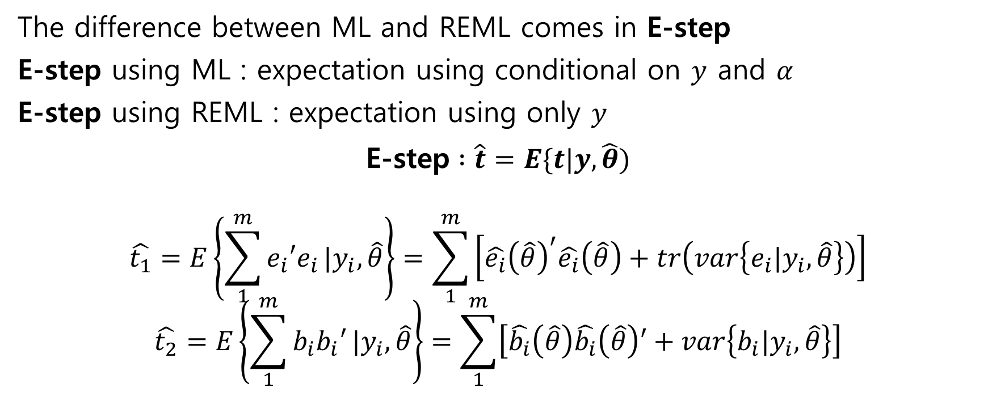
5.REML Estimation and Computation
The difference between ML and REML comes in E-step
E-step using ML : expectation using conditional on $y$ and $α$
E-step using REML : expectation using only $y$
$$\text{E}\text{−}\text{step} :\hat{t}=E\{t|y,\hat{θ})$$
$$\hat{t_{1}}=E\left\{\sum_{1}^{m}{e_{i}′e_{i}}|y_{i},\hat{θ}\right\}=\sum_{1}^{m}{\left[{\hat{e_{i}}\left(\hat{θ}\right)}^{′}\hat{e_{i}}\left(\hat{θ}\right)+tr\left(var\left\{e_{i}|y_{i},\hat{θ}\right\}\right)\right]}$$
$$\hat{t_{2}}=E\left\{\sum_{1}^{m}{b_{i}b_{i}′}|y_{i},\hat{θ}\right\}=\sum_{1}^{m}{\left[\hat{b_{i}}\left(\hat{θ}\right)\hat{b_{i}}\left(\hat{θ}\right)′+var\left\{b_{i}|y_{i},\hat{θ}\right\}\right]}$$

Slide 53
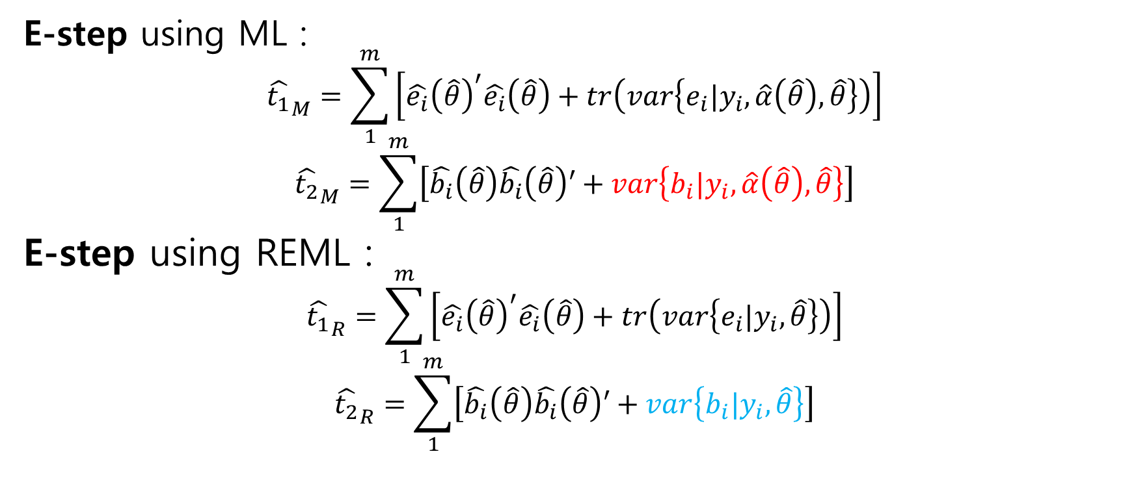
5.REML Estimation and Computation
E-step using ML :
$${\hat{t_{1}}}_{M}=\sum_{1}^{m}{\left[{\hat{e_{i}}\left(\hat{θ}\right)}^{′}\hat{e_{i}}\left(\hat{θ}\right)+tr\left(var\left\{e_{i}|y_{i},\hat{α}\left(\hat{θ}\right),\hat{θ}\right\}\right)\right]}$$
$${\hat{t_{2}}}_{M}=\sum_{1}^{m}{\left[\hat{b_{i}}\left(\hat{θ}\right)\hat{b_{i}}\left(\hat{θ}\right)′+var\left\{b_{i}|y_{i},\hat{α}\left(\hat{θ}\right),\hat{θ}\right\}\right]}$$
E-step using REML :
$${\hat{t_{1}}}_{R}=\sum_{1}^{m}{\left[{\hat{e_{i}}\left(\hat{θ}\right)}^{′}\hat{e_{i}}\left(\hat{θ}\right)+tr\left(var\left\{e_{i}|y_{i},\hat{θ}\right\}\right)\right]}$$
$${\hat{t_{2}}}_{R}=\sum_{1}^{m}{\left[\hat{b_{i}}\left(\hat{θ}\right)\hat{b_{i}}\left(\hat{θ}\right)′+var\left\{b_{i}|y_{i},\hat{θ}\right\}\right]}$$

Slide 54
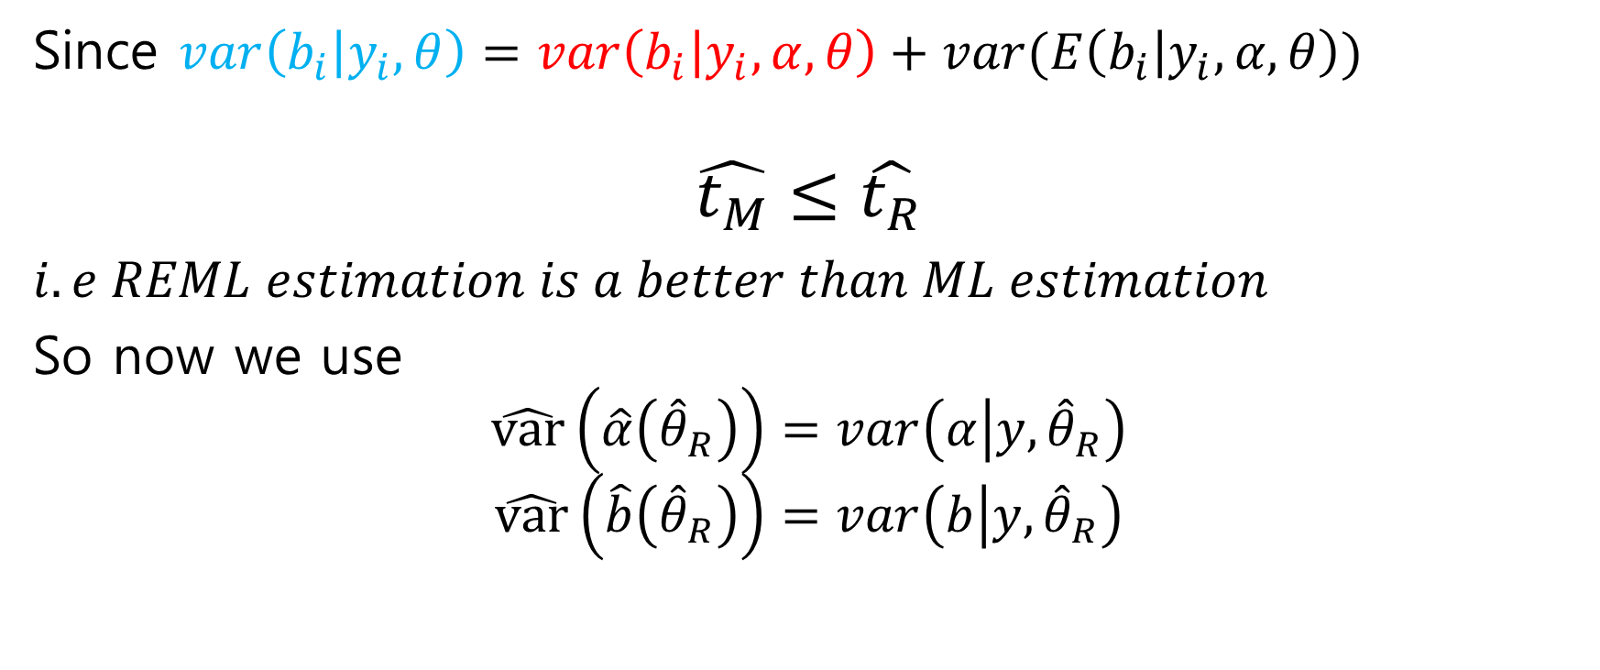
5.REML Estimation and Computation
Since $var\left(b_{i} | y_{i},θ\right)=var\left(b_{i} | y_{i},α,θ\right)+var(E\left(b_{i} | y_{i},α,θ\right))$
$$\hat{t_{M}}≤\hat{t_{R}}$$
$i.e REML estimation is a better than ML estimation$
So now we use
$$\hat{var}\left(\hat{α}\left({\hat{θ}}_{R}\right)\right)=var\left(α | y,{\hat{θ}}_{R}\right)$$
$$\hat{var}\left(\hat{b}\left({\hat{θ}}_{R}\right)\right)=var\left(b | y,{\hat{θ}}_{R}\right)$$

Slide 55
6.Examples
Analysis of the effect of air pollution episodes on pulmonary function – repeated measures design
Analyzing the effect of air pollutants on pulmonary function development – growth curve analysis

Slide 56
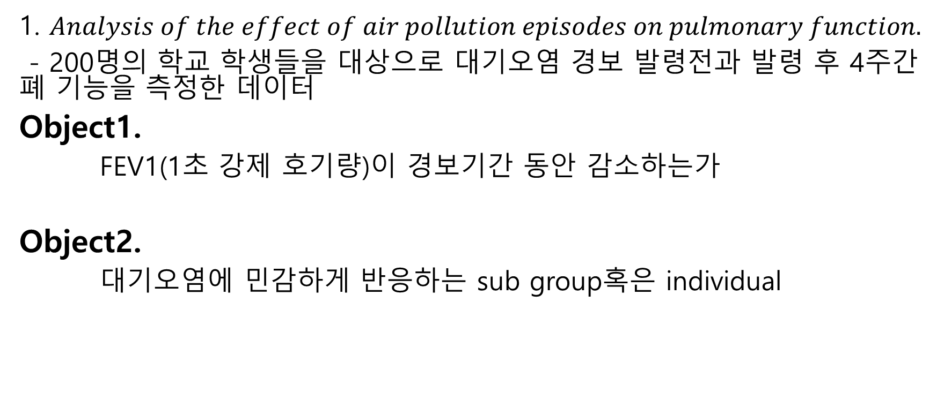
6. Examples
1. $Analysis of the effect of air pollution episodes on pulmonary function.$
- 200명의 학교 학생들을 대상으로 대기오염 경보 발령전과 발령 후 4주간 폐 기능을 측정한 데이터
Object1.
FEV1(1초 강제 호기량)이 경보기간 동안 감소하는가
Object2.
대기오염에 민감하게 반응하는 sub group혹은 individual

Slide 57
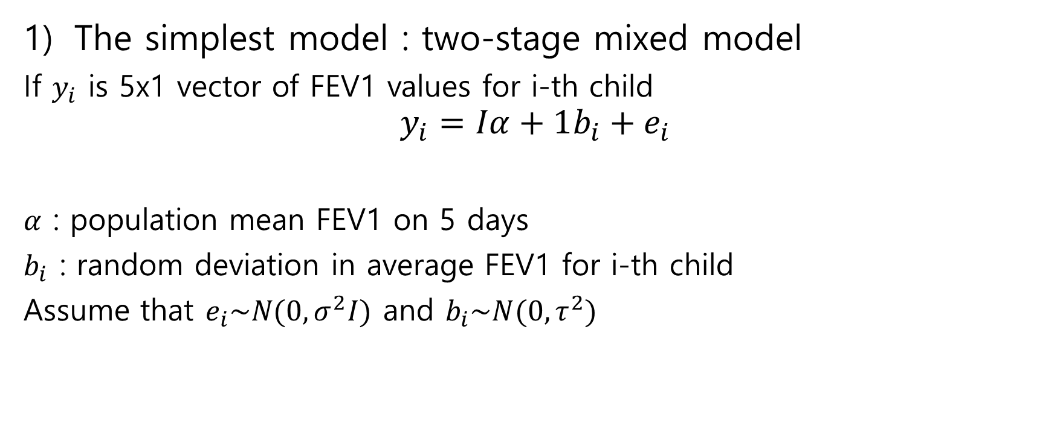
6. Examples
The simplest model : two-stage mixed model
If $y_{i}$ is 5x1 vector of FEV1 values for i-th child
$$y_{i}=Iα+1b_{i}+e_{i}$$
$α$ : population mean FEV1 on 5 days
$b_{i}$ : random deviation in average FEV1 for i-th child
Assume that $e_{i}\sim N(0,σ^{2}I)$ and $b_{i}\sim N(0,τ^{2})$

Slide 58
6. Examples
The simplest model : two-stage mixed model
This data were analyzed using standard multivariate methods, with following findings
(1) a decline in FEV1 was observed on and after the alert day
(2) the variances and covariances for the last four measurements were larger than those baseline day

Slide 59
6. Examples
1-2) second random effect model
경보발령 당일과 그 후로 증가하는 분산은 오염의 노출에 대해 개인의 반응이 다르다는 가설과 일치한다.
민감한 개인에 대한 개념은 대기오염 연구에서 중요한 개념이다.
이를 반영하여 second random effect 를 제시할 수 있다.

Slide 60

6. Examples
1-2) second random effect model
$$y_{i}=X_{i}α+Z_{i}b_{i}+e_{i}$$
$X_{i}, α, e_{i}$ is the same before but,
$$b_{i}={\left(\begin{matrix}b_{1i} & b_{2i}\end{matrix}\right)}^{T} and Z_{i}=\left[\begin{matrix}1 & 0 \\ 1 & 1 \\ \begin{matrix}⋮ \\ 1\end{matrix} & \begin{matrix}⋮ \\ 1\end{matrix}\end{matrix}\right]$$

Slide 61
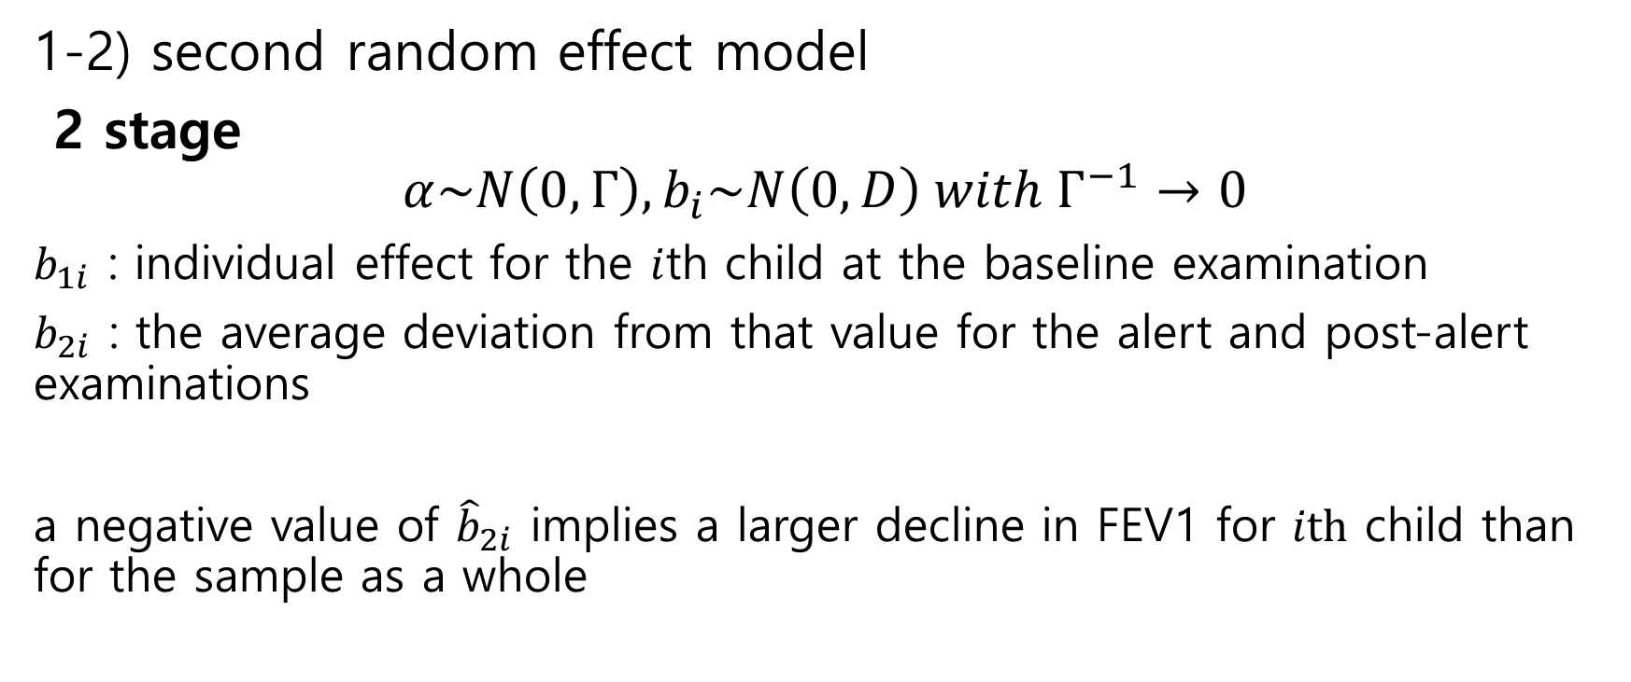
6. Examples
1-2) second random effect model
2 stage
$$α\sim N\left(0,Γ\right), b_{i}\sim N\left(0,D\right) with Γ^{−1}→0$$
$b_{1i}$ : individual effect for the $i$th child at the baseline examination
$b_{2i}$ : the average deviation from that value for the alert and post-alert examinations
a negative value of ${\hat{b}}_{2i}$ implies a larger decline in FEV1 for $ith$ child than for the sample as a whole

Slide 62

6. Examples
1-2) second random effect model
$b_{2i}$ 의 추정치는 어떤 학생이 FEV1의 감소 값이 큰지 나타내는 값이며 실제 이후의 연구에서 20명의 학생이 음수 값을 가진 것으로 나타났으며 이중 대부분의 학생이 이 기간동안 감기에 걸린 것으로 나타났다.

Slide 63

6. Examples
1-2) second random effect model
성별, 인종, 거주지역 등 다른 특성들의 영향을 연구하기 위해 이러한 요인들을 포함하는 모델을 생성할 수 있다.
Let $v_{i}$ is the vector of individual characteristics for ith child.
Let $b_{1i} and{ b}_{2i}$ have linear regressions on these factors
$$b_{1i}=v_{i}′γ_{1}{+b′}_{1i}$$
$$b_{2i}=v_{i}′γ_{2}{+b′}_{2i}$$
Where ${b′}_{1i},{b′}_{2i}$ are the individual deviations from the regression model

Slide 64

6. Examples
1-2) second random effect model
$$i.e. b_{i}=\left[\begin{matrix}v_{i}′ & 0 \\ 0 & v_{i}′\end{matrix}\right]\left[\begin{matrix}γ_{1} \\ γ_{2}\end{matrix}\right]+b_{i}^{′}$$
$$=V_{i}γ+b_{i}′$$
And the model for $y_{i}$ is
$$y_{i}=X_{i}α+{Z_{i}b}_{i}+e_{i}$$
$$=X_{i}α+Z_{i}\left(V_{i}γ+b_{i}^{′}\right)+e_{i}$$
$$=\left[\begin{matrix}X_{i} & Z_{i}V_{i}\end{matrix}\right]\left[\begin{matrix}α \\ γ\end{matrix}\right]+Z_{i}b_{i}^{′}+e_{i}$$
this new model in the general family

Slide 65

6. Examples
2) $Analyzing the effect of air pollutants on pulmonary function development$
학생들의 폐기능발전의 수준과 속도에 담배연기와 화석연료 연소물질이
영향을 미치는지 확인하기 위해 총 2000명의 학생들을 6개의 도시에서
매년 검사하였다.
FEV1에 영향을 주는 주된 요인은 신체 사이즈다. 여기선 키로 표현된다.
반응변수 $y_{i}$가 growth-curve model일 경우, 다음을 가정한다.
Each child has a vector of growth-curve parameters ${b_{i}}^{∗}$ and a growth-curve
model $y_{i}|{b_{i}}^{∗}={X_{i}b_{i}}^{∗}+e_{i}$ at stage 1 and ${b_{i}}^{∗}\sim N\left(β,D\right)$ at stage 2

Slide 66

6. Examples
2) $Analyzing the effect of air pollutants on pulmonary function development$
If $b_{i}={b_{i}}^{∗}−β$ centers the individual effects at 0, the model can be expressed by
$$y_{i}=X_{i}β+X_{i}b_{i}+e_{i}$$
Similar to example 1, the value of the growth parameters depend on linearly in a vector of individual characteristics $v_{i}$
Through the relationship ${b_{i}}^{∗}=V_{i}γ+b_{i}$, where
$$V_{i}=\left[\begin{matrix}v_{i} & 0 & 0 \\ 0 & ⋱ & 0 \\ 0 & 0 & v_{i}\end{matrix}\right]$$

Slide 67

6. Examples
Then the model can be expressed as
$$Y_{i}=X_{i}V_{i}γ+X_{i}b_{i}+e_{i}$$
And still belongs to the family of growth-curves.
However, if changes in some of the individual characteristics, such as air pollution concentration, stove type or smoking in the home, can alter the expected rate of growth, the general linear model is required for representation of this relationship

